Slide 1
Shell scripting
by Roshini Peyyala

Slide 2
Topics to be covered :
What is shell?
Using variables
Special variables
Using Arrays
Basic Operators
Decision Making
Shell loops
Loop Control
Shell substitutions
Quoting Mechanisms
IO Redirections
Shell Functions
Regular Expression
File system Basics
User Administration
System Performance
System Logging
Signals and Traps

Slide 3
What is shell ?
The shell can be defined as a command interpreter within an operating system.
It gathers input from you and executes programs based on that input.
The shell sends the result to the user over the screen when it has completed running a program which is the common output device. That's why it is known as "command interpreter".
the shell is a programming language with complete constructs of a programming language such as functions, variables, loops, conditional execution, and many others.

Slide 4
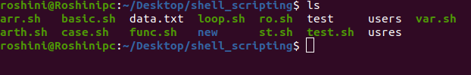
Shell Prompt :
The prompt, $, which is called the command prompt, is issued by the shell. While the prompt is displayed, you can type a command.
Root user prompt is # while the non-root user prompt is $.

Slide 5
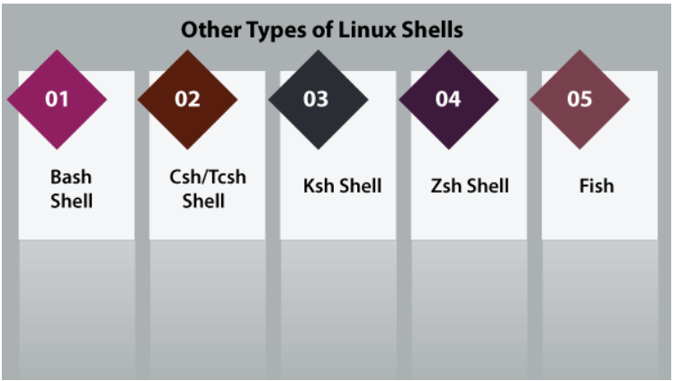
Types :
Bourne Again shell
It facilitates practical improvements on sh for interactive and programming use which contains:
Job Control
Command-line editing
Shell Aliases and Functions
Unlimited size command history
C-shell/ TENEX-C-shell
Tcsh is an upgraded C shell.
This shell can be used as a shell script command processor and interactive login shell.
Korn-shell
Ksh shell is a high-level, powerful, and complete programming language
It is a reciprocal command language as well just like various other GNU/Unix Linux shells.
Z-shell
Zsh shell is developed to be reciprocal and it combines various aspects of other GNU/Unix Linux shells like ksh, tcsh, and bash.
Friendly interactive shell
Fish shell was developed to be fully user-friendly and interactive just like other shells.
Web-based configuration
Man page completions
Auto-suggestions

Slide 6
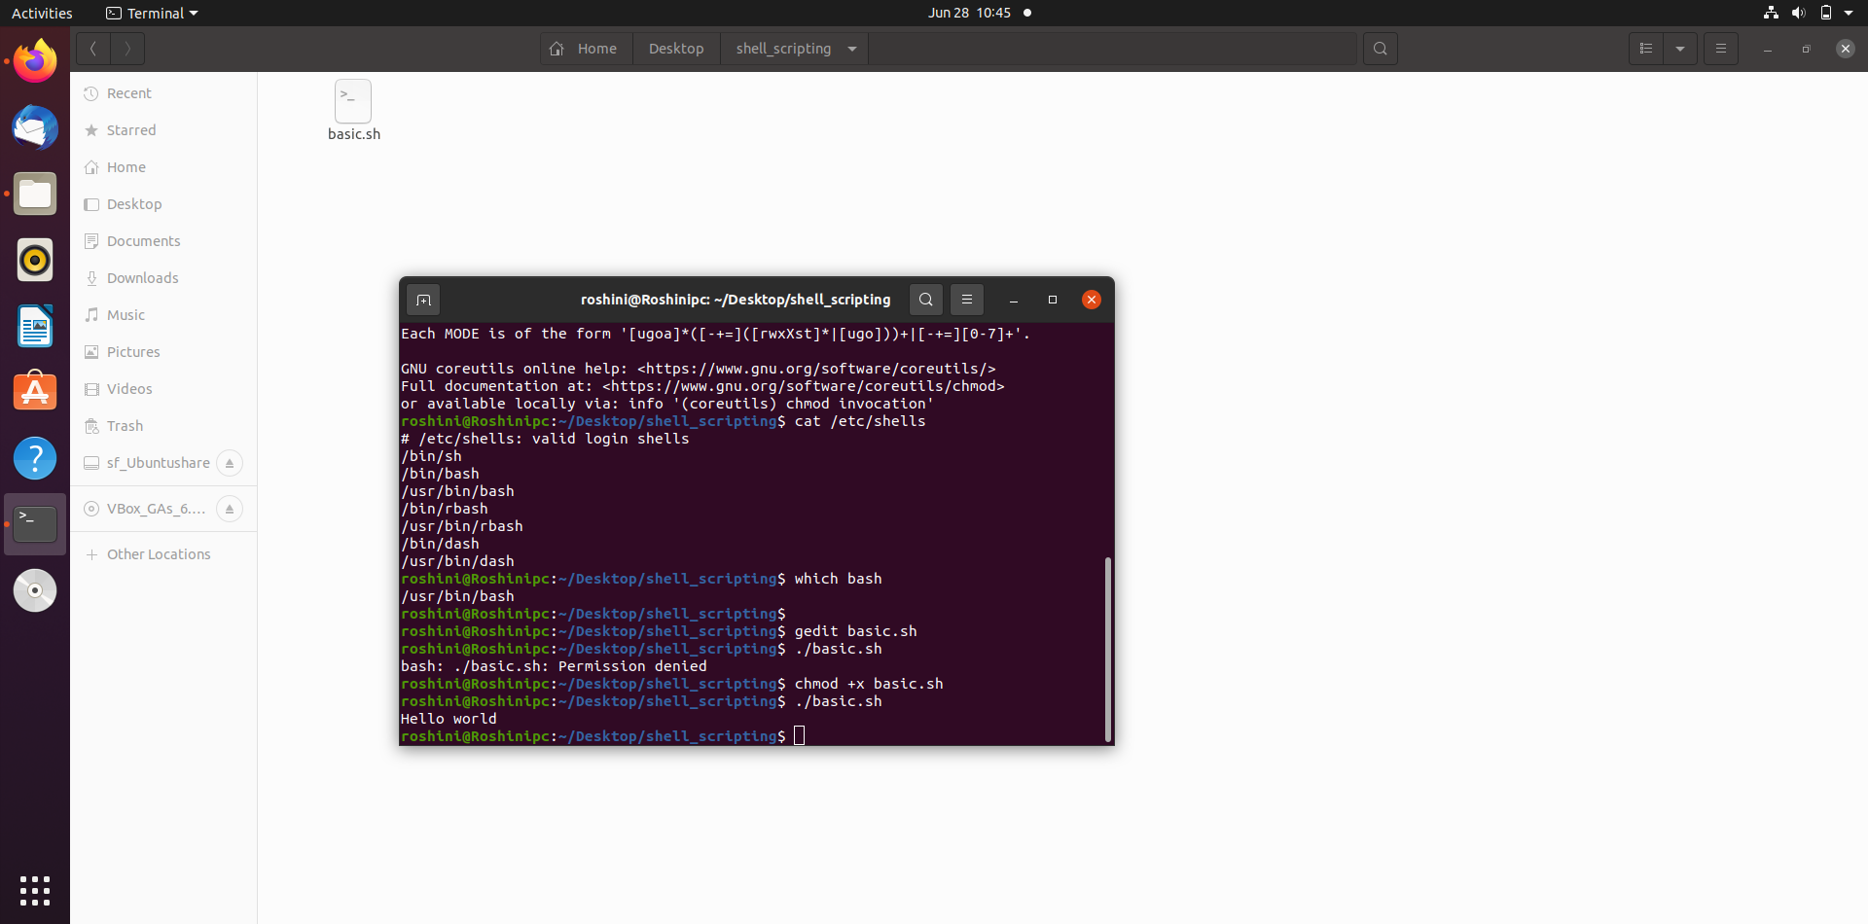
To know which are the shell scripts will be supported by OS
type - cat /etc/shells
To know which shell we are using
type - which bash

Slide 7
Shell scripting :
As shell can also take commands as input from file we can write these commands in a file and can execute them in shell to avoid this repetitive work.
These files are called Shell Scripts or Shell Programs.
Shebang starts with #! characters and the path to the bash or other interpreter of your choice.
Extension : .sh i.e., filename.sh
We can comment the line by using #.
# commenting single line.
For commenting multiple lines
Use : ' to open and ' to close.
or
<< command to open and command to close
#! /usr/bin/bash
# system variables --> # to comment single line
: '
to comment multiple lines
‘
<< doc
to comment multiple lines
doc

Slide 8
Why shell script needed ?
For avoiding automation and repetitive work.
The syntax and command are exactly similar to those entered directly in a command line. Thus, the programmers don't have to switch to completely different syntax.
It is much quicker to write the shell scripts .
Disadvantages :
A single error can modify the command which could be harmful, so prone to very costly errors.
Slower execution speed.
Not well suited for complex and large tasks etc.

Slide 9
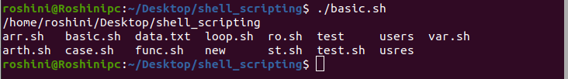
To make a script including these commands, we put the shebang construct line first, and after that add any command:
To run the above code
Save the file with .sh extension
To get the file executed
chmod +x filename.sh
To get output ./filename.sh
#! /usr/bin/bash # shebang line
pwd # it will print present working directories
ls # it will give the list of the files

Slide 10
Using Variables :
A variable is nothing more than a pointer to the actual data. The shell enables you to create, assign, and delete variables.
Variable Names
The name of a variable can contain only letters (a to z or A to Z), numbers ( 0 to 9) or the underscore character ( _).
The reason you cannot use other characters such as !, *, or - is that these characters have a special meaning for the shell.
Invalid Names
2_var
-var
Var-three
Valid Names
_var1
var_2
var_three

Slide 11
To print the data use keyword echo
echo “statements to print”
Read Variable :
To get the input from the keyboard use read command.
Read command takes input from the keyboard and assigns it to a variable
read variable
Read multiple data from single read command
read var1 var2 var3 ….. Varn
-p flag is uses to enter the input in the same line
read –p “Enter the name : ” var_name
To make input silent use -sp flag.
To store the array of elements in one variable use -a flag
read -a names
$REPLY - built in variable used to store data without giving any variable while reading

Slide 12
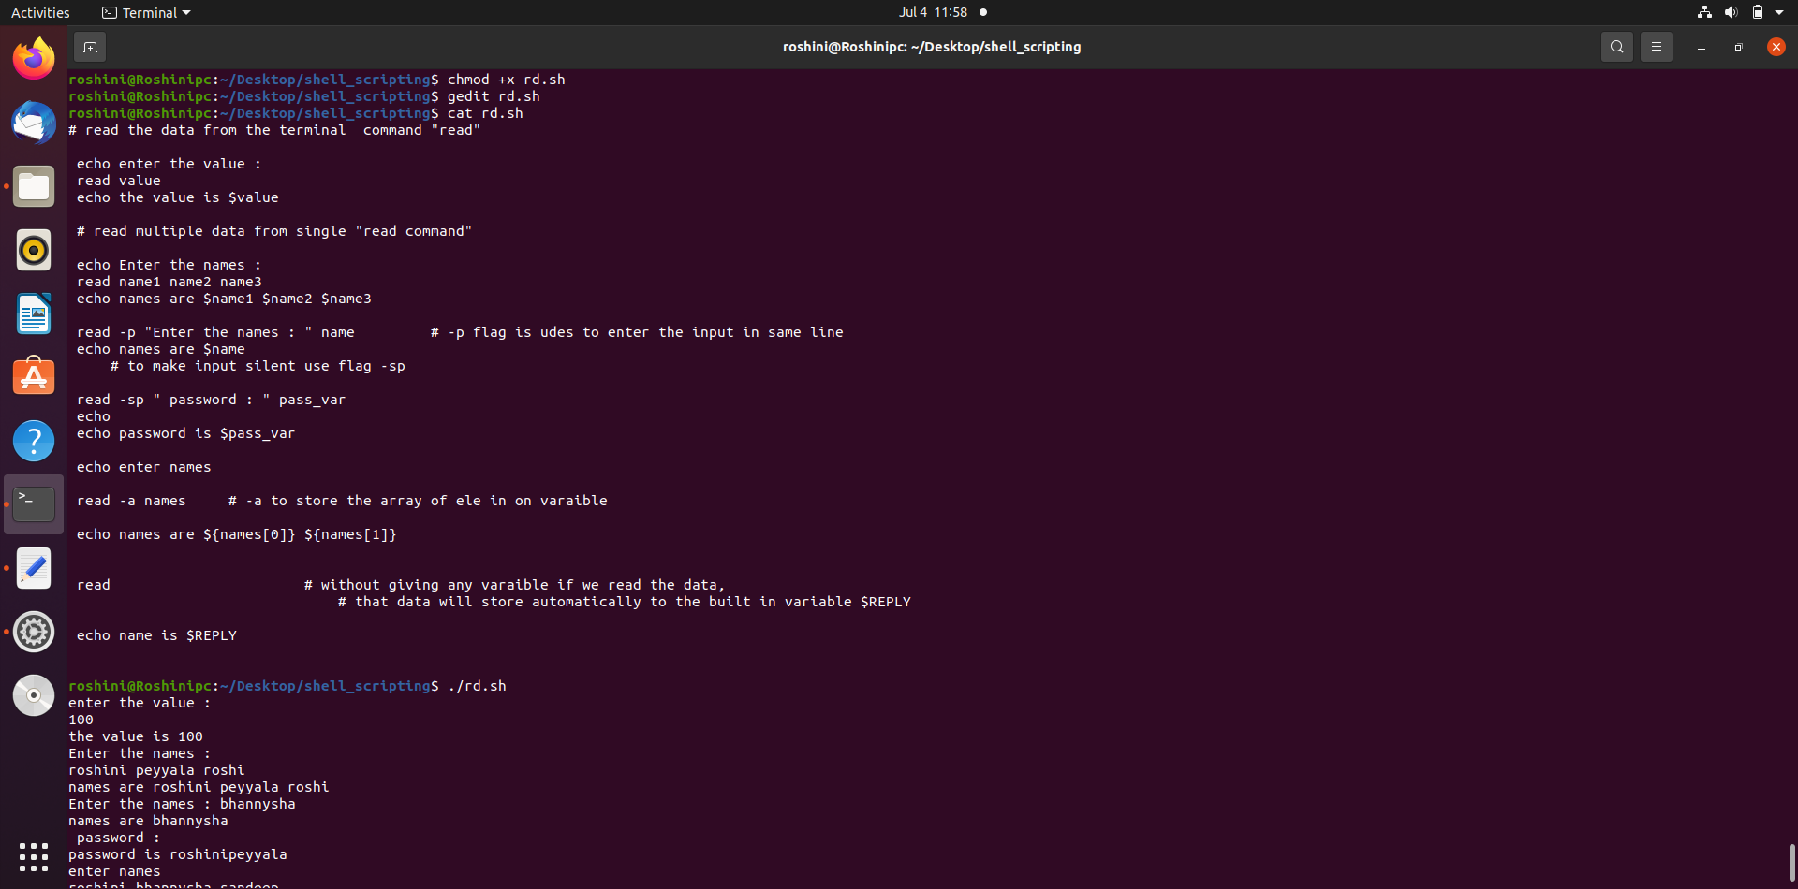
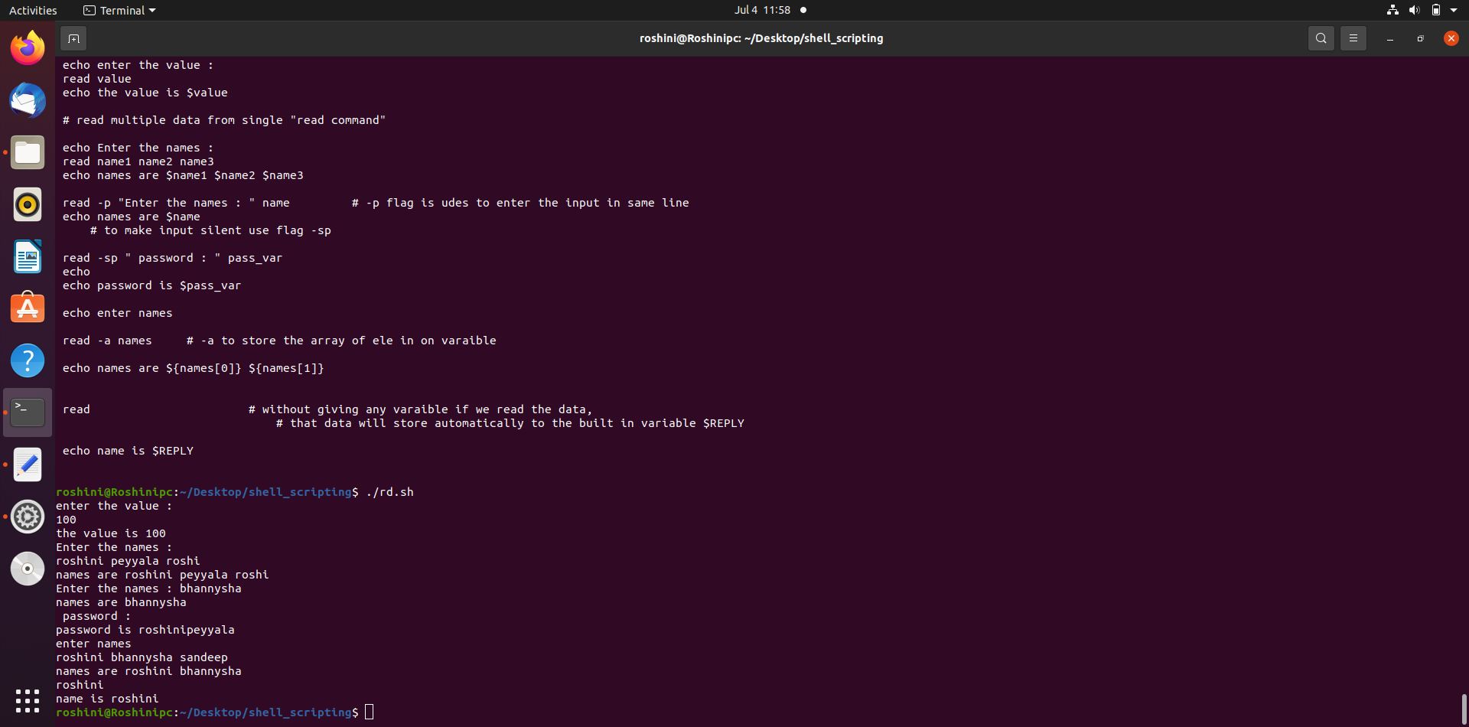

Slide 13
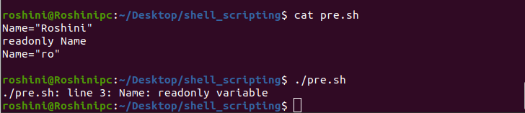
Defining a variables :
Variables can be defined as
var_name=var_value
Ex : Name=“Roshini”
Variables of this type are scalar variables.
Name=“Roshini”
Value=100
To access the value stored in a variable, prefix its name with the dollar sign ($) −
Name=“Roshini”
echo $Name
Out put : Roshini
Read-only Variables :
Shell provides a way to mark variables as read-only by using the read-only command.
After a variable is marked read-only, its value cannot be changed.

Slide 14
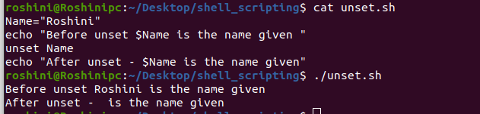
Unsetting Variables
Unsetting or deleting a variable directs the shell to remove the variable from the list of variables that it tracks. Once you unset a variable, you cannot access the stored value in the variable.
Following is the syntax to unset a defined variable using the unset command −
unset var_name

Slide 15
Special Variables :
Sr.No. | Variable & Description
1 | $0 The filename of the current script.
2 | $n These variables correspond to the arguments with which a script was invoked. Here n is a positive decimal number corresponding to the position of an argument (the first argument is $1, the second argument is $2, and so on).
3 | $# The number of arguments supplied to a script.
4 | $* All the arguments are double quoted. If a script receives two arguments, $* is equivalent to $1 $2.
5 | $@ All the arguments are individually double quoted. If a script receives two arguments, $@ is equivalent to $1 $2.
6 | $? The exit status of the last command executed.

Slide 16
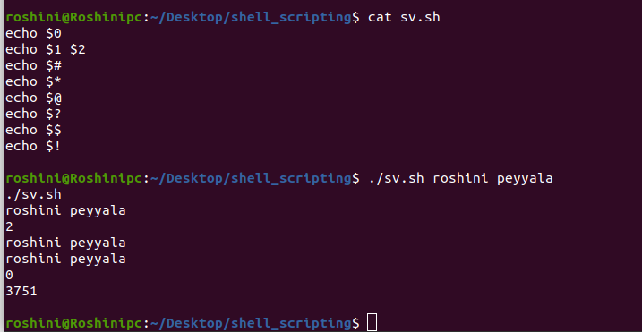
7 | $$ The process number of the current shell. For shell scripts, this is the process ID under which they are executing.
8 | $! The process number of the last background command.

Slide 17
Using Shell Arrays :
Shell supports a different type of variable called an array variable.
This can hold multiple values at the same time.
Defining Array Values :
The difference between an array variable and a scalar variable can be explained as follows.
Suppose you are trying to represent the names of various students as a set of variables.
Each of the individual variables is a scalar variable as follows
Name1=“Roshini”
Name2=“Bannysha”
Name3=“Sandeep”
We can use a single array to store all the above mentioned names.
array_name[index]=value

Slide 18
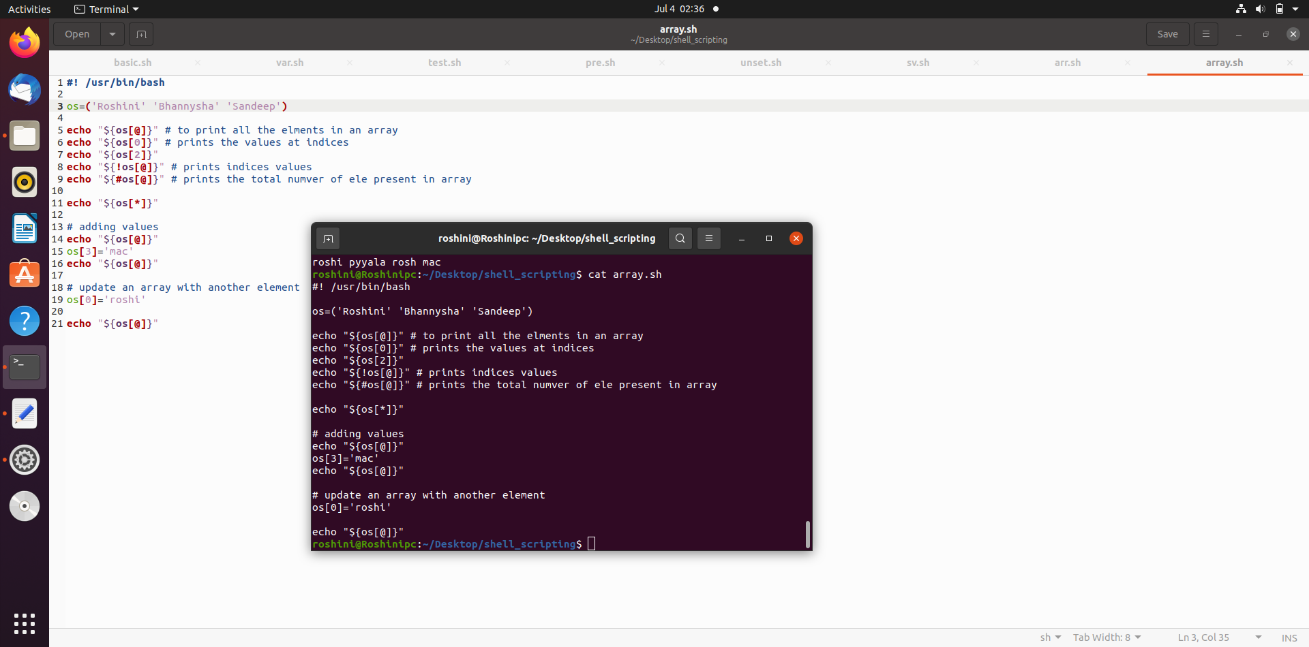
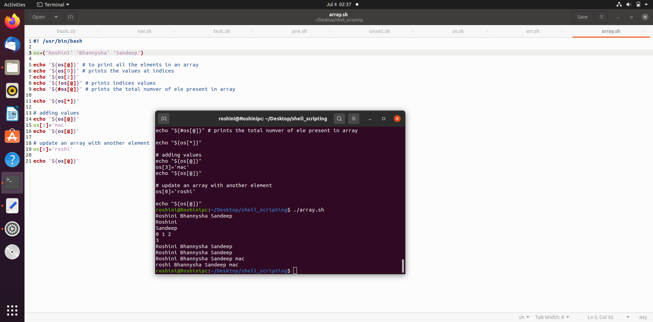
Here array_name is the name of the array, index is the index of the item in the array that you want to set, and value is the value you want to set for that item.
Name[0]=“Roshini”
Name[1]=“Bannysha”
Name[2]=“Sandeep”
Name=(“Roshini” “Bannysha” “sandeep”)
Accessing Array Values :
After you have set any array variable we can access by using below syntax
${array_name[index]}

Slide 19
Basics Operators :
Arithmetic Operators
Relational Operators
Boolean Operators
String Operators
File Test Operators

Slide 20
Arithmetic Operators :
if a=10 , b=20
Operator | Description | Example
+ (Addition) | Adds values on either side of the operator | `expr $a + $b` will give 30
- (Subtraction) | Subtracts right hand operand from left hand operand | `expr $a - $b` will give -10
* (Multiplication) | Multiplies values on either side of the operator | `expr $a \* $b` will give 200
/ (Division) | Divides left hand operand by right hand operand | `expr $b / $a` will give 2
% (Modulus) | Divides left hand operand by right hand operand and returns remainder | `expr $b % $a` will give 0
= (Assignment) | Assigns right operand in left operand | a = $b would assign value of b into a
== (Equality) | Compares two numbers, if both are same then returns true. | [ $a == $b ] would return false.
!= (Not Equality) | Compares two numbers, if both are different then returns true. | [ $a != $b ] would return true.

Slide 21
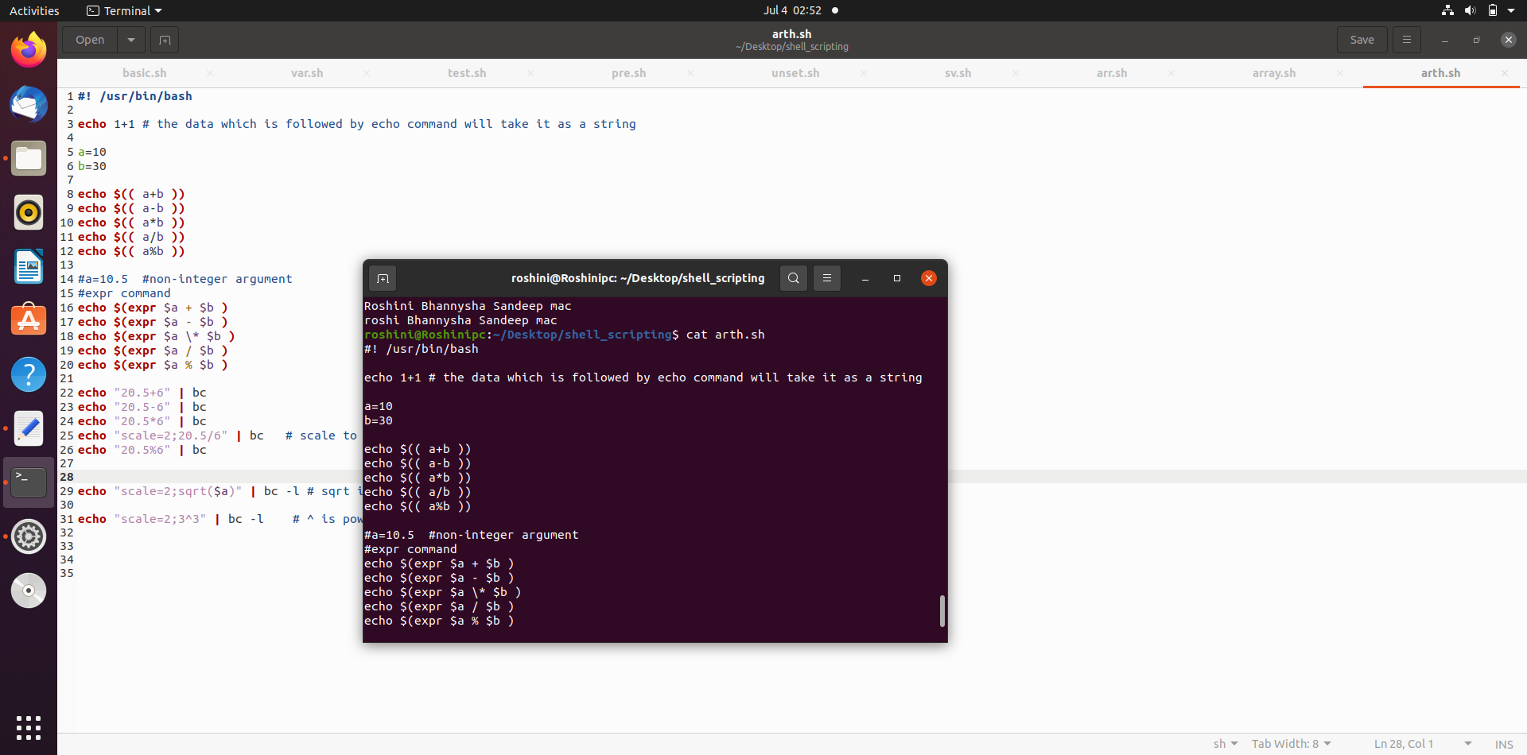
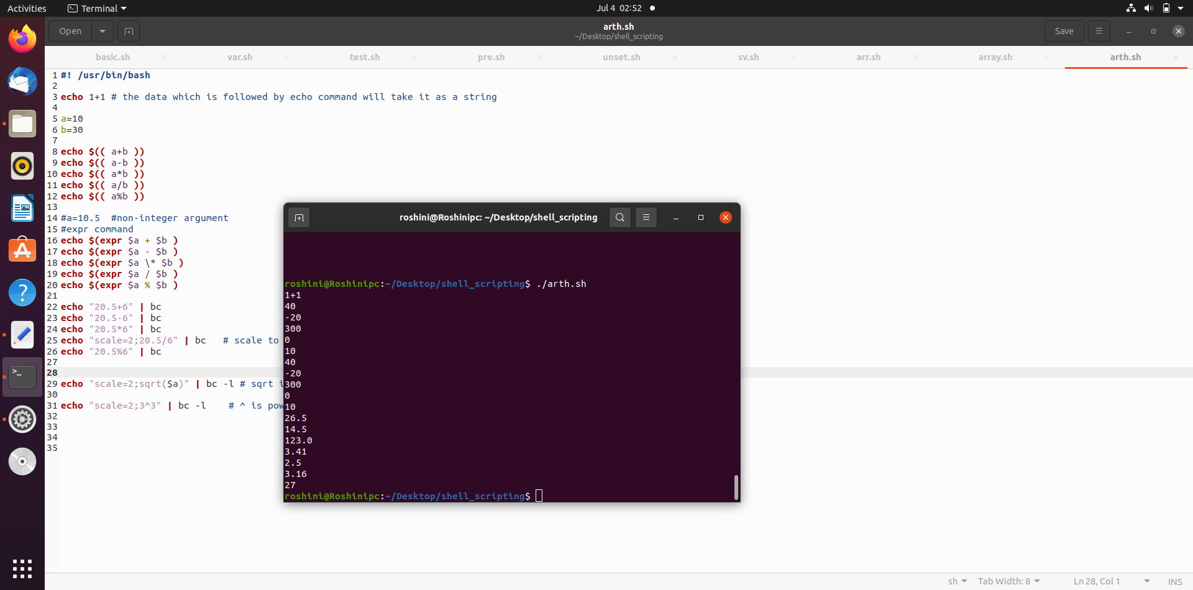
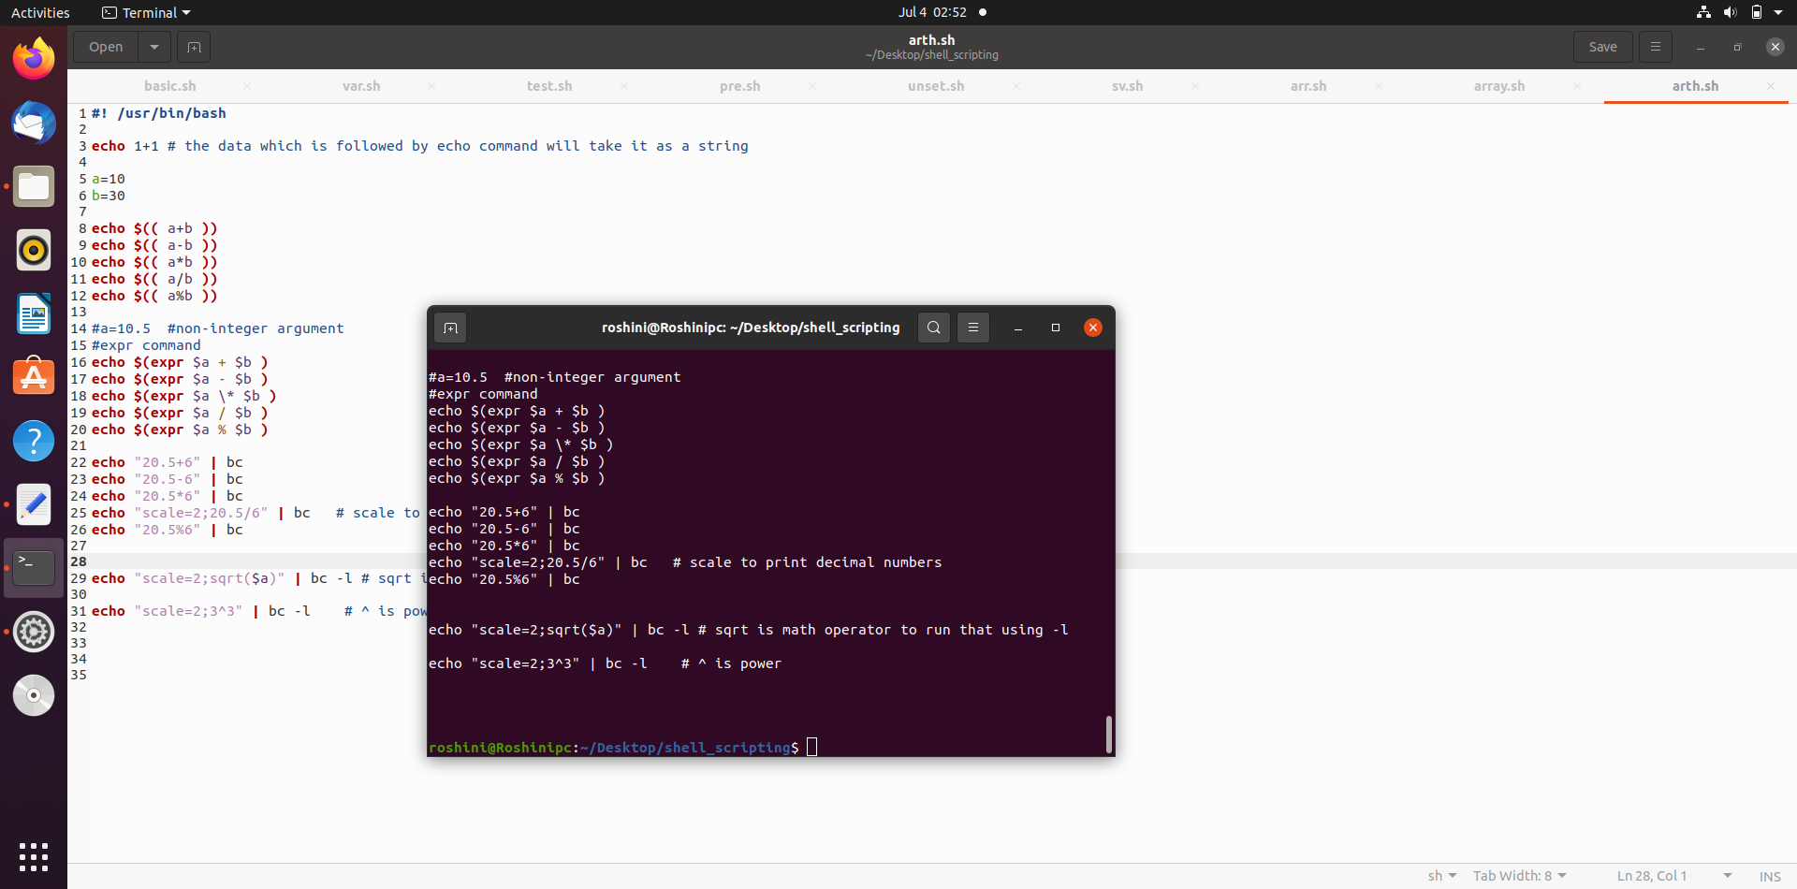

Slide 22
Relational Operators :
Operator | Description | Example
-eq | Checks if the value of two operands are equal or not; if yes, then the condition becomes true. | [ $a -eq $b ] is not true.
-ne | Checks if the value of two operands are equal or not; if values are not equal, then the condition becomes true. | [ $a -ne $b ] is true.
-gt | Checks if the value of left operand is greater than the value of right operand; if yes, then the condition becomes true. | [ $a -gt $b ] is not true.
-lt | Checks if the value of left operand is less than the value of right operand; if yes, then the condition becomes true. | [ $a -lt $b ] is true.
-ge | Checks if the value of left operand is greater than or equal to the value of right operand; if yes, then the condition becomes true. | [ $a -ge $b ] is not true.
-le | Checks if the value of left operand is less than or equal to the value of right operand; if yes, then the condition becomes true. | [ $a -le $b ] is true.

Slide 23
Boolean Operators :
Operator | Description | Example
! | This is logical negation. This inverts a true condition into false and vice versa. | [ ! false ] is true.
-o | This is logical OR. If one of the operands is true, then the condition becomes true. | [ $a -lt 20 -o $b -gt 100 ] is true.
-a | This is logical AND. If both the operands are true, then the condition becomes true otherwise false. | [ $a -lt 20 -a $b -gt 100 ] is false.

Slide 24
String Operators :
Operator | Description | Example
= | Checks if the value of two operands are equal or not; if yes, then the condition becomes true. | [ $a = $b ] is not true.
!= | Checks if the value of two operands are equal or not; if values are not equal then the condition becomes true. | [ $a != $b ] is true.
-z | Checks if the given string operand size is zero; if it is zero length, then it returns true. | [ -z $a ] is not true.
-n | Checks if the given string operand size is non-zero; if it is nonzero length, then it returns true. | [ -n $a ] is not false.
str | Checks if str is not the empty string; if it is empty, then it returns false. | [ $a ] is not false.

Slide 25
File Test Operators :
Operator | Description | Example
-b file | Checks if file is a block special file; if yes, then the condition becomes true. | [ -b $file ] is false.
-c file | Checks if file is a character special file; if yes, then the condition becomes true. | [ -c $file ] is false.
-d file | Checks if file is a directory; if yes, then the condition becomes true. | [ -d $file ] is not true.
-f file | Checks if file is an ordinary file as opposed to a directory or special file; if yes, then the condition becomes true. | [ -f $file ] is true.
-g file | Checks if file has its set group ID (SGID) bit set; if yes, then the condition becomes true. | [ -g $file ] is false.
-k file | Checks if file has its sticky bit set; if yes, then the condition becomes true. | [ -k $file ] is false.
-p file | Checks if file is a named pipe; if yes, then the condition becomes true. | [ -p $file ] is false.

Slide 26
-t file | Checks if file descriptor is open and associated with a terminal; if yes, then the condition becomes true. | [ -t $file ] is false.
-u file | Checks if file has its Set User ID (SUID) bit set; if yes, then the condition becomes true. | [ -u $file ] is false.
-r file | Checks if file is readable; if yes, then the condition becomes true. | [ -r $file ] is true.
-w file | Checks if file is writable; if yes, then the condition becomes true. | [ -w $file ] is true.
-x file | Checks if file is executable; if yes, then the condition becomes true. | [ -x $file ] is true.
-s file | Checks if file has size greater than 0; if yes, then condition becomes true. | [ -s $file ] is true.
-e file | Checks if file exists; is true even if file is a directory but exists. | [ -e $file ] is true.

Slide 27
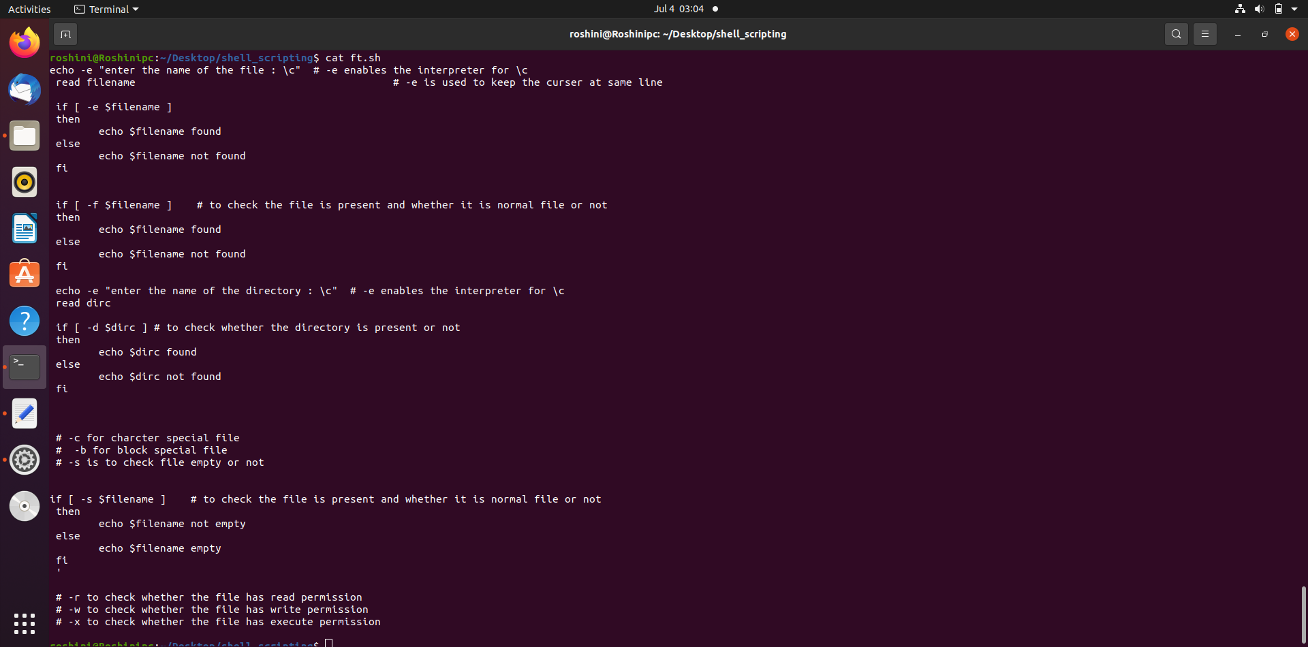
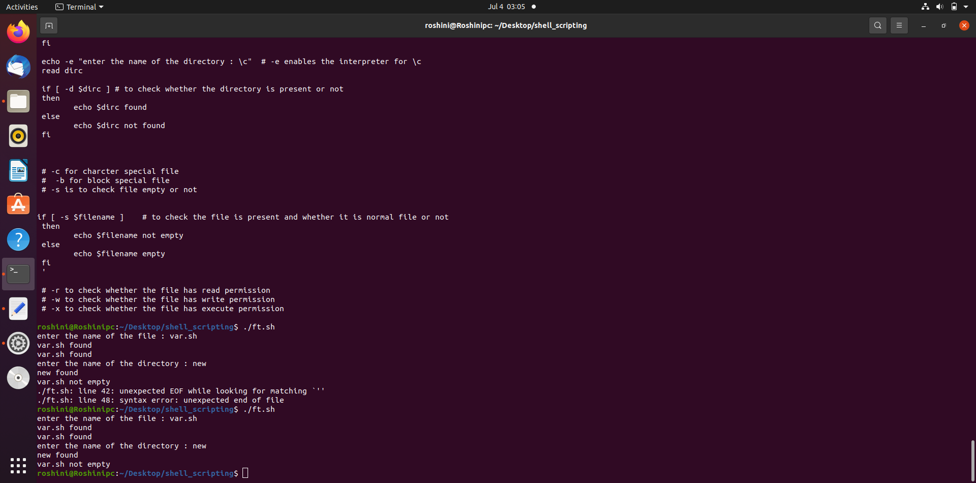

Slide 28
Decision Making :
Unix Shell supports conditional statements which are used to perform different actions based on different conditions.
The if...else statement
The case...esac statement
If…else :
if...fi statement
if...else...fi statement
if...elif...else...fi statement
case…esca :
case...esac statement

Slide 29
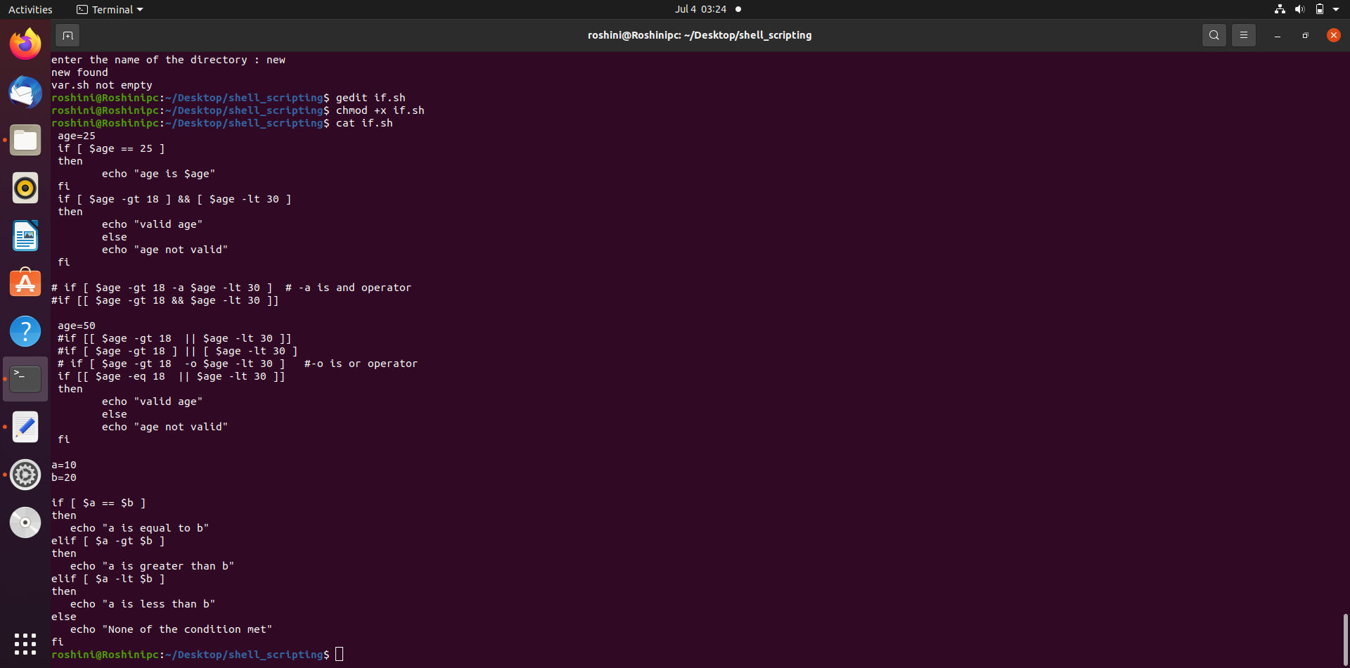
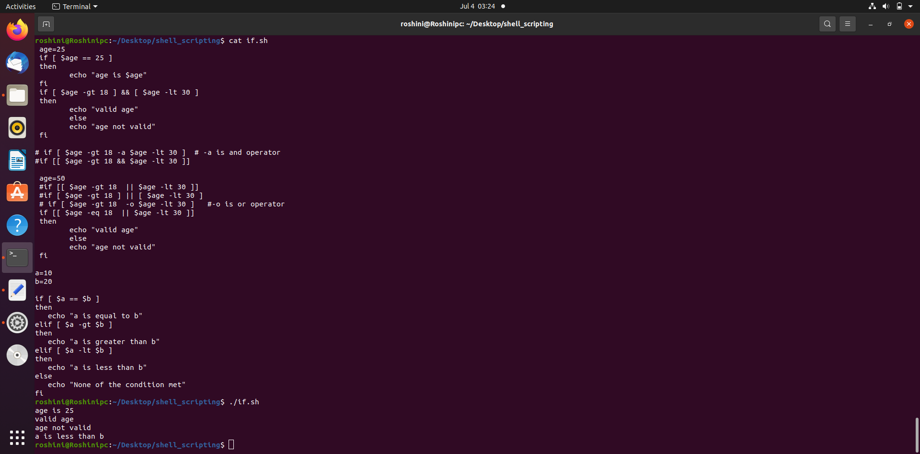
If…fi
if…else…fi
if [ exp 1 ]
then
statements
fi
if [ exp 1 ]
then
statements
else
statements
fi
if…elif…fi
if [ exp 1 ]
then
statements
elif [ exp 2 ]
then
statements
else
statements
fi

Slide 30
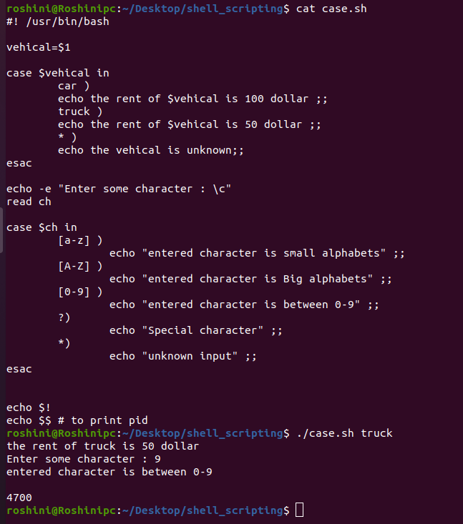
case…esac :
case word in
pattern1)
Statement(s) to be executed if pattern1 matches
;;
pattern2)
Statement(s) to be executed if pattern2 matches
;;
pattern3) Statement(s) to be executed if pattern3 matches
;;
*)
Default condition to be executed
;;
esac

Slide 31
Shell loops:
The while loop
The for loop
The until loop
The select loop
Nested loop
We will use different loops based on the situation.
For example, the while loop executes the given commands until the given condition remains true.
the until loop executes until a given condition becomes true.

Slide 32
The while loop :
The while loop enables you to execute a set of commands repeatedly until some condition occurs.
Syntax
while command
do
Statement(s) to be executed if command is true
done

Slide 33
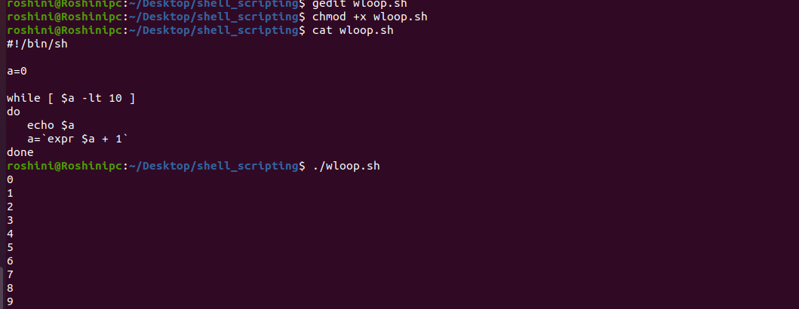

Slide 34
The for loop :
The for loop operates on lists of items. It repeats a set of commands for every item in a list.
Syntax
for var in word1 word2 ... wordN
do
Statement(s) to be executed for every word.
done

Slide 35
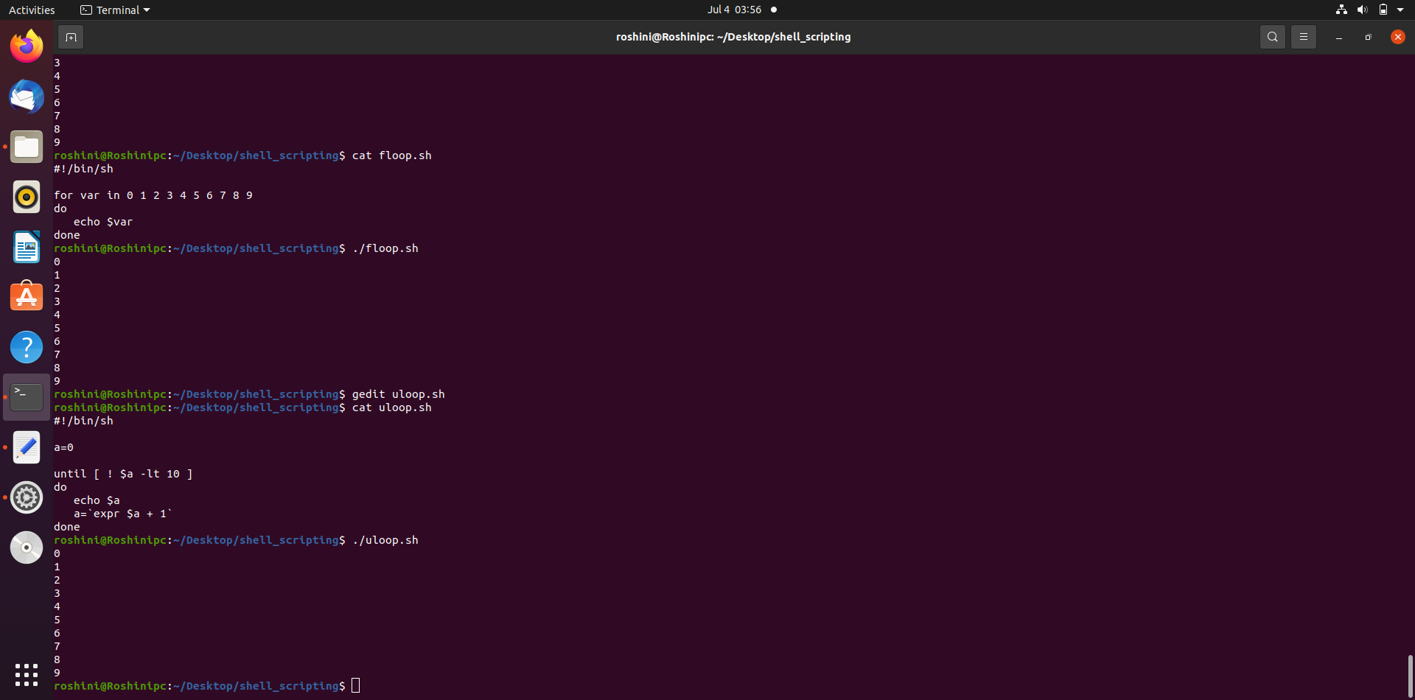

Slide 36
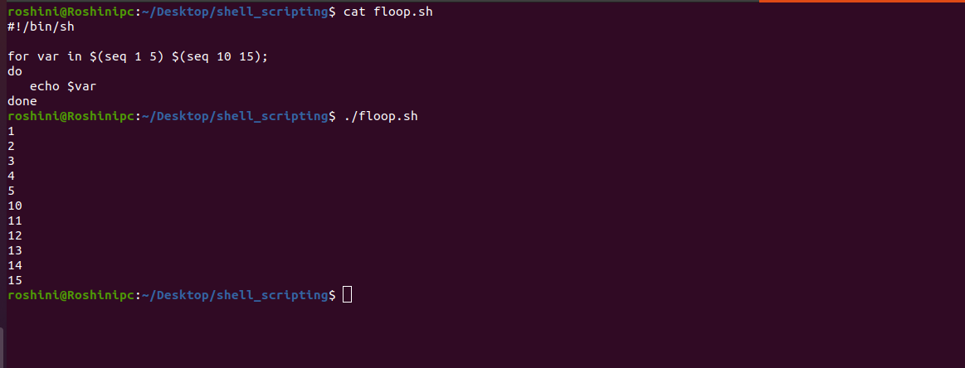
To represent sequential number use ‘seq’

Slide 37
The until loop :
The while loop is perfect for a situation where you need to execute a set of commands while some condition is true.
Sometimes you need to execute a set of commands until a condition is true.
Syntax
until command
do
Statement(s) to be executed until command is true
done

Slide 38
The select loop :
The select loop provides an easy way to create a numbered menu from which users can select options.
It is useful when you need to ask the user to choose one or more items from a list of choices.
Syntax
select var in word1 word2 ... wordN
do
Statement(s) to be executed for every word.
done

Slide 39
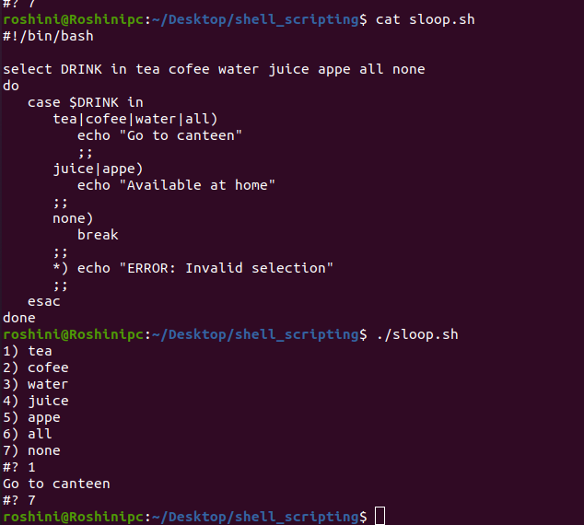

Slide 40
Nested Loop :
It is possible to use a while loop as part of the body of another while loop.
Syntax
while command1 ; # this is loop1, the outer loop
do
Statement(s) to be executed if command1 is true
while command2 ; # this is loop2, the inner loop
do
Statement(s) to be executed if command2 is true
done
Statement(s) to be executed if command1 is true
done

Slide 41
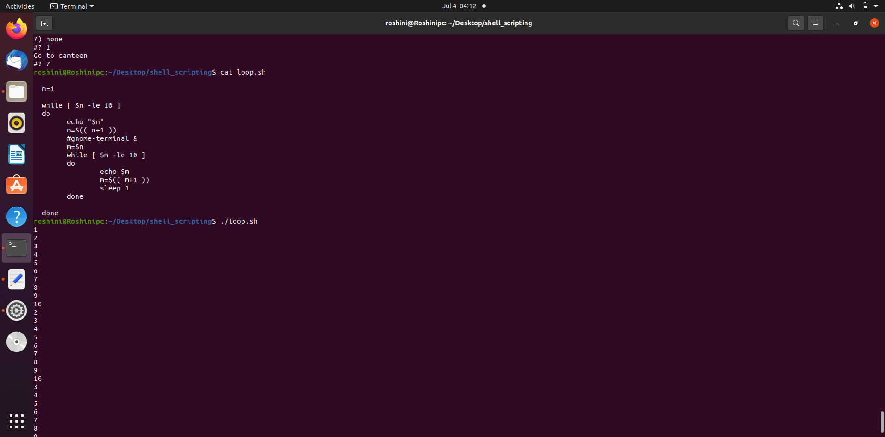

Slide 42
The break statement :
The break statement is used to terminate the execution of the entire loop, after completing the execution of all of the lines of code up to the break statement.
Example :
#!/bin/bash
a=0
while [ $a -lt 10 ]
do
echo $a
if [ $a -eq 5 ]
then
break
fi
a=`expr $a + 1`
done
Output :
0
1
2
3
4
5

Slide 43
The continue statement:
The continue statement is similar to the break command, except that it causes the current iteration of the loop to exit, rather than the entire loop.
Example :
#!/bin/bash
NUMS="1 2 3 4 5 6 7"
for NUM in $NUMS
do
Q=`expr $NUM % 2`
if [ $Q -eq 0 ]
then
echo "Number is an even number!!" continue
fi
echo "Found odd number"
done
Output :
Found odd number
Number is an even number!!
Found odd number
Number is an even number!!
Found odd number
Number is an even number!!
Found odd number

Slide 44
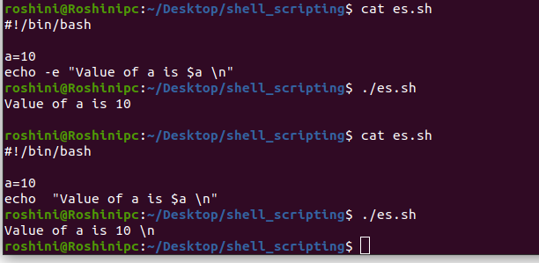
What is Substitution?
The shell performs substitution when it encounters an expression that contains one or more special characters.
Example
Here, the printing value of the variable is substituted by its value. Same time, "\n" is substituted by a new line.
The -e option enables the interpretation of backslash escapes.

Slide 45
Sr.No. | Escape & Description
1 | \\ backslash
2 | \a alert (BEL)
3 | \b backspace
4 | \c suppress trailing newline
5 | \f form feed
6 | \n new line
7 | \r carriage return
8 | \t horizontal tab
9 | \v vertical tab

Slide 46
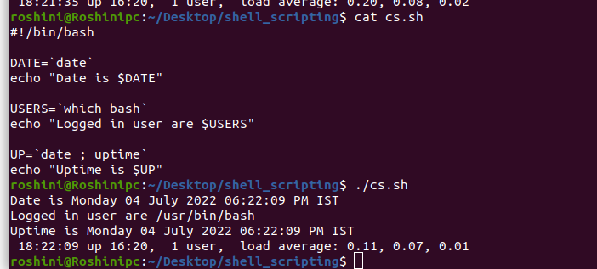
Command Substitution :
Command substitution is the mechanism by which the shell performs a given set of commands and then substitutes their output in the place of the commands.
Command substitution can be performed like `command `

Slide 47
Variable Substitution :
Variable substitution enables the shell programmer to manipulate the value of a variable based on its state.
Sr.No. | Form & Description
1 | ${var} Substitute the value of var.
2 | ${var:-word} If var is null or unset, word is substituted for var. The value of var does not change.
3 | ${var:=word} If var is null or unset, var is set to the value of word.
4 | ${var:?message} If var is null or unset, message is printed to standard error. This checks that variables are set correctly.
5 | ${var:+word} If var is set, word is substituted for var. The value of var does not change.

Slide 48
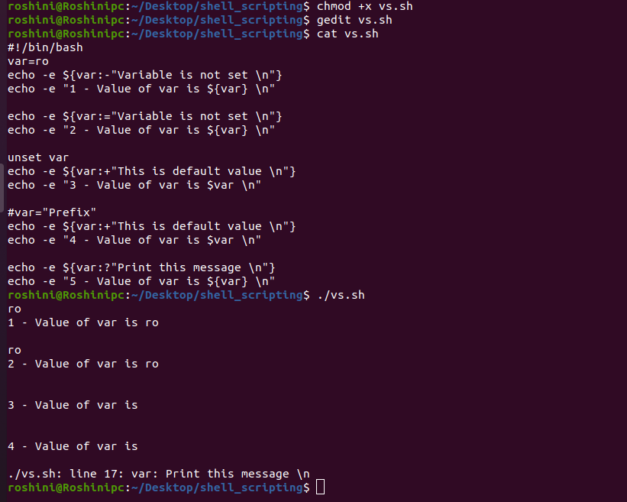

Slide 49
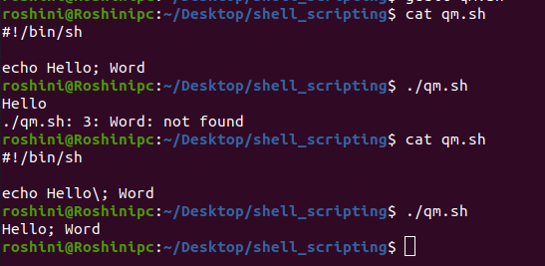
Quoting Mechanisms:
Unix Shell provides various metacharacters which have special meaning while using them in any Shell Script and causes termination of a word unless quoted.
For example, ? matches with a single character while listing files in a directory and an * matches more than one character. Here is a list of most of the shell special characters (also called metacharacters) −
* ? [ ] ' " \ $ ; & ( ) | ^ < > new-line space tab
A character may be quoted (i.e., made to stand for itself) by preceding it with a \.

Slide 50
Sr.No. | Quoting & Description
1 | Single quote All special characters between these quotes lose their special meaning.
2 | Double quote Most special characters between these quotes lose their special meaning with these exceptions − $ ` \$ \' \" \\
3 | Backslash Any character immediately following the backslash loses its special meaning.
4 | Back quote Anything in between back quotes would be treated as a command and would be executed.

Slide 51
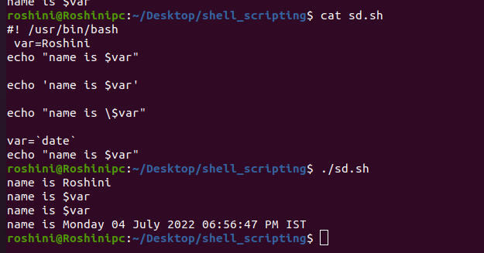

Slide 52
I/O Redirections :
System commands take input from your terminal and send resulting output back to your terminal
Output Redirection
Output from a command normally intended for standard output can be easily diverted to a file instead
Greater-than character > is used for output redirection
>> is used for append the data
Input Redirection
The input of a command be redirected from a file
Less than character < is used to redirect the input

Slide 53
Sr.No. | Command & Description
1 | pgm > file Output of pgm is redirected to file
2 | pgm < file Program pgm reads its input from file
3 | pgm >> file Output of pgm is appended to file
4 | n > file Output from stream with descriptor n redirected to file
5 | n >> file Output from stream with descriptor n appended to file
6 | n >& m Merges output from stream n with stream m
7 | n <& m Merges input from stream n with stream m
8 | << tag Standard input comes from here through next tag at the start of line
9 | | Takes output from one program, or process, and sends it to another

Slide 54
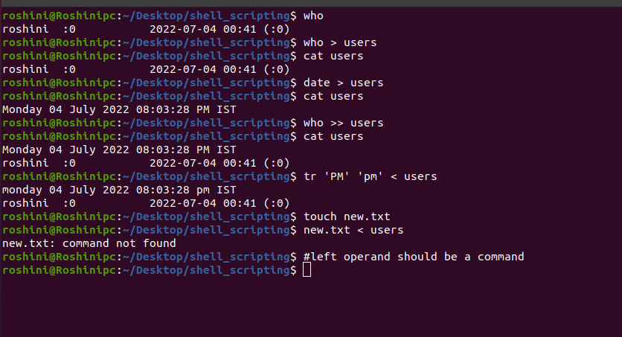

Slide 55
Shell Functions :
Using functions to perform repetitive tasks is an excellent way to create code reuse.
Creating Functions
To declare a function,
syntax
function function_name ()
{
list of commands
}
function_name
Example :
#!/bin/bash
# Define your function here
Hello ()
{
echo "Hello World"
}
# Invoke your function
Hello
Output :
Hello World

Slide 56
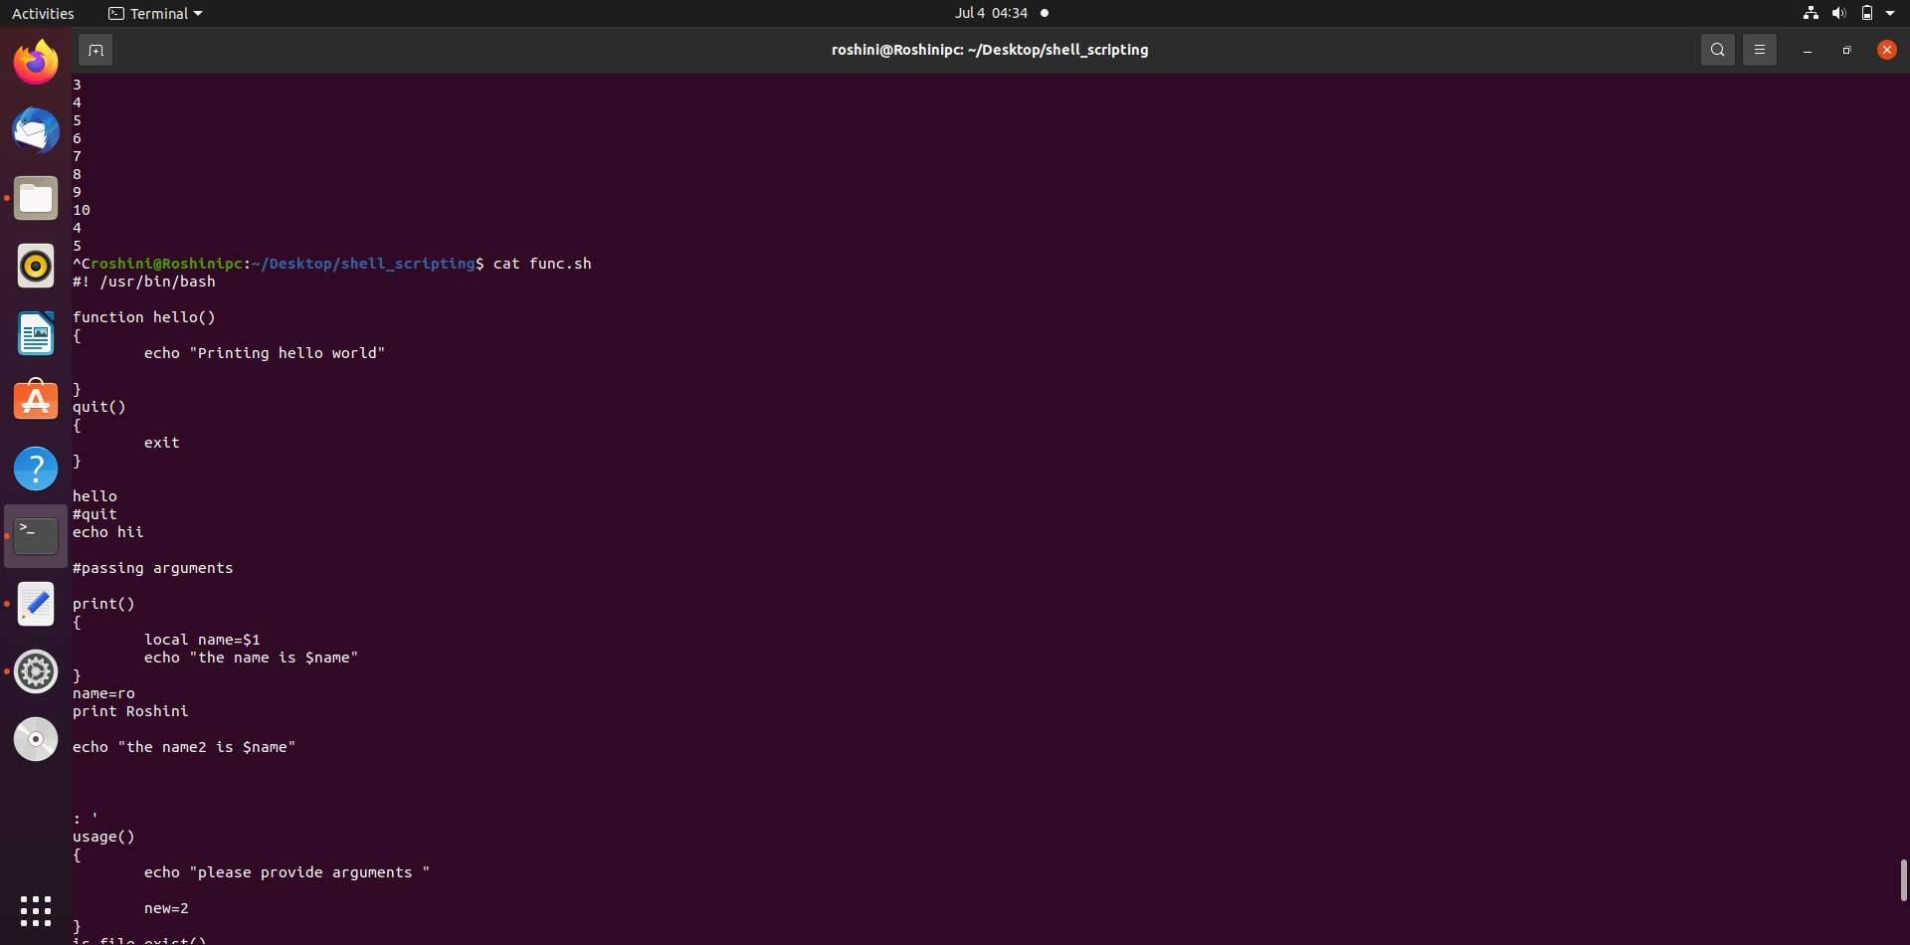
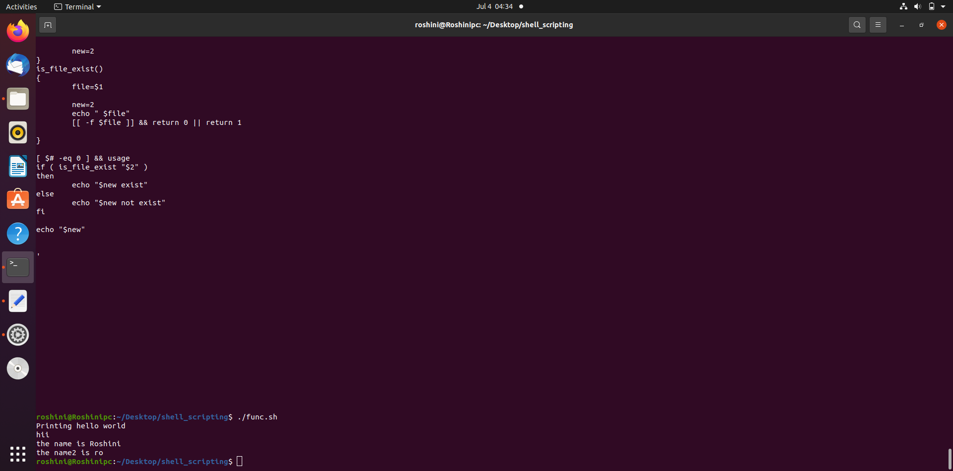
Pass Parameters to a Function :
You can define a function that will accept parameters while calling the function.
These parameters would be represented by $1, $2 and so on.

Slide 57
Returning Values from Functions :
If you execute an exit command from inside a function, its effect is not only to terminate execution of the function but also of the shell program that called the function.
If you instead want to just terminate execution of the function, then there is way to come out of a defined function.
Based on the situation you can return any value from your function using the return command
Example :
#!/bin/bash
# Define your function here
Hello ()
{
echo "Hello World $1 $2"
return 10
}
# Invoke your function
Hello Roshini Alekya # Capture value returnd by last command ret=$?
echo "Return value is $ret"
Output:
Hello World Roshini Alekya
Return value is 10

Slide 58
Nested Functions :
One of the more interesting features of functions is that they can call themselves and also other functions.
Example :
#!/bin/bash
# Calling one function from another
number_one ()
{
echo "This is the first function speaking...“
number_two
}
number_two ()
{
echo "This is now the second function speaking..."
}
# Calling function one.
number_one
Output :
This is the first function speaking...
This is now the second function speaking...

Slide 59
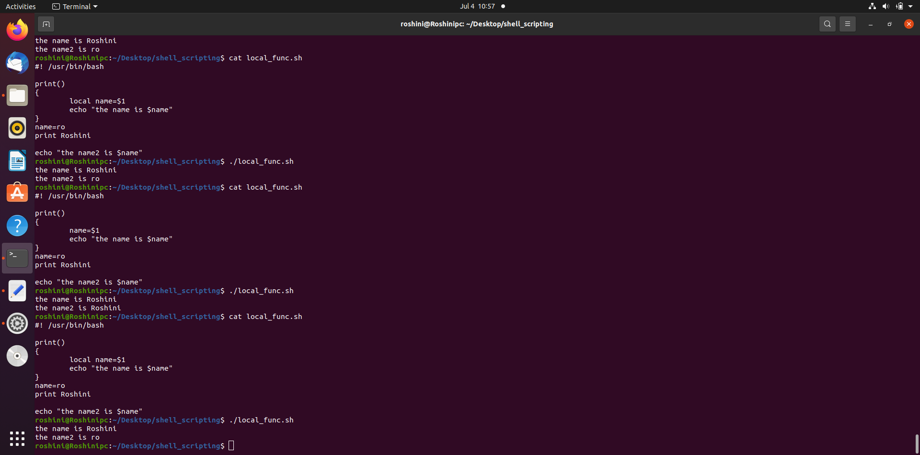
Local Variables :
By default every variable which we declare in the script is global variable.
By initializing a variable with keyword local makes that variable local to that function.
Ex : local name=“Roshini”
local: can only be used in a function

Slide 60
File system basics :
A file system is a collection of files on a partition/disk.
A partition is a container for information
Everything in Unix is considered to be a file, including physical devices such as DVD-ROMs, USB devices, and floppy drives.
Directory Structure :
Unix uses a hierarchical file system structure, just like a tree , with root(/) at the base of the file system and all other directories spreading from there
Each file or directory is uniquely identified by its name, the directory in which it resides, and a unique identifier, typically called an inode.
File inode numbers can be seen by specifying the -i option to ls command.

Slide 61
Sr.No. | Directory & Description
1 | / This is the root directory which should contain only the directories needed at the top level of the file structure
2 | /bin This is where the executable files are located. These files are available to all users
3 | /dev These are device drivers
4 | /etc Supervisor directory commands, configuration files, disk configuration files, valid user lists, groups, ethernet, hosts, where to send critical messages
5 | /lib Contains shared library files and sometimes other kernel-related files
6 | /boot Contains files for booting the system
7 | /home Contains the home directory for users and other accounts

Slide 62
8 | /mnt Used to mount other temporary file systems, such as cdrom and floppy for the CD-ROM drive and floppy diskette drive, respectively
9 | /proc Contains all processes marked as a file by process number or other information that is dynamic to the system
10 | /tmp Holds temporary files used between system boots
11 | /usr Used for miscellaneous purposes, and can be used by many users. Includes administrative commands, shared files, library files, and others
12 | /var Typically contains variable-length files such as log and print files and any other type of file that may contain a variable amount of data
13 | /sbin Contains binary (executable) files, usually for system administration. For example, fdisk and ifconfig utlities
14 | /kernel Contains kernel files

Slide 63
Navigating the File System :
10 | more filename Browses through a file from the beginning to the end
11 | mv file1 file2 Moves the location of, or renames a file/directory
12 | pwd Shows the current directory the user is in
13 | rm filename Removes a file
14 | rmdir dirname Removes a directory
15 | tail filename Shows the end of a file
16 | touch filename Creates a blank file or modifies an existing file or its attributes
17 | whereis filename Shows the location of a file
18 | which filename Shows the location of a file if it is in your PATH
Sr.No. | Command & Description
1 | cat filename Displays a filename
2 | cd dirname Moves you to the identified directory
3 | cp file1 file2 Copies one file/directory to the specified location
4 | file filename Identifies the file type (binary, text, etc)
5 | find filename dir Finds a file/directory
6 | head filename Shows the beginning of a file
7 | less filename Browses through a file from the end or the beginning
8 | ls dirname Shows the contents of the directory specified

Slide 64
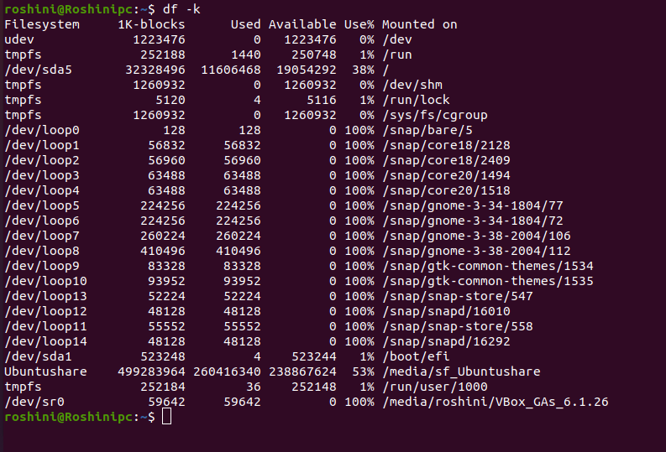
The df & du command (disk-free) :
The df command displays the disk space usage in kilobytes $df -k
The du (disk usage) command enables you to specify directories to show disk space usage on a particular directory.
$du or $du -h /etc here -h option to display the output in easy to understand notation

Slide 65
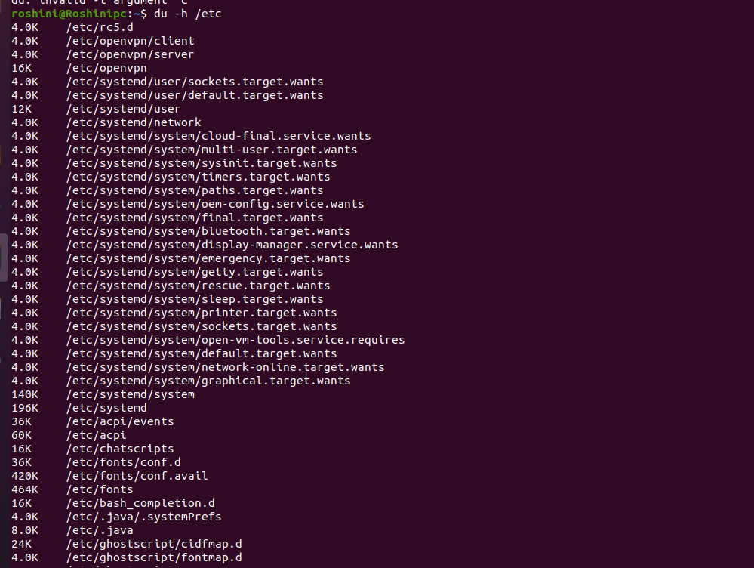

Slide 66
Mounting the File System :
A file system must be mounted in order to be usable by the system.
To see what is currently mounted (available for use) on your system, use mount command
The /mnt directory, by the Unix convention, is where temporary mounts (such as CDROM drives, remote network drives, and floppy drives) are located.
If you need to mount a file system, you can use the mount command with the following syntax
mount -t file_system_type device_to_mount directory_to_mount_to
Unmount the file :
To unmount (remove) the file system from your system, use the umount command by identifying the mount point or device.
$umount where_device_mounted

Slide 67
Regular Expression :
A regular expression (regex) is a method of representing a string matching pattern.
Regular expressions enable strings that match a particular pattern within textual data records to be located and modified and they are often used within utility programs and programming languages that manipulate textual data
Regular Expression Metacharacters :
Metacharacter | Description
. | Replaces any character.
^ | Matches start of string and represents characters not in the string.
$ | Matches end of string.
* | Matches zero or more times the preceding character.
\ | Represents the group of characters.
() | Groups regular expressions.

Slide 68
? | Matches exactly one character.
+ | Matches one or more times the preceding character.
{N} | Preceding character is matched exactly N times.
{N,} | Preceding character is matched exactly N times or more.
{N,M} | Preceding character is matched exactly N times, but not more than M times.
- | Represents the range.
\b | Matches empty string at the edge of a word.
\B | Matches empty string if it is not at the edge of a word.
\< | Matches empty string at the beginning of a word.
\> | Matches empty string at the end of a word.

Slide 69
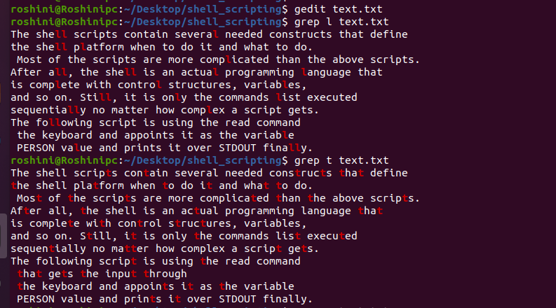
Linux grep Regular Expressions :
Print Lines Matching A Pattern
The grep command will search for line that matches the specified pattern.
Syntax:
grep <pattern> <fileName>

Slide 70
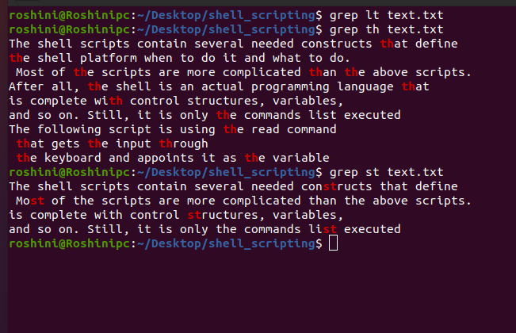
Concatenating Characters
If a pattern is of concatenating characters then it has to be matched as it is, for the line to be displayed.

Slide 71
The grep tool has the following options to use regular expressions:
-E : String is read as ERE (Extended Regular Expressions)
-G : String is read as BRE (Basic Regular Expressions)
-P : String is read as PRCE (Perl Regular Expressions)
-F : String is read literally
One Or The Other
Here pipe (|) symbol is used as OR to signify one or the other. All the three versions are shown. Options -E and -P syntax are same but -G syntax uses (\).
Syntax:
grep <option> <'pattern|pattern'> <fileName>

Slide 72
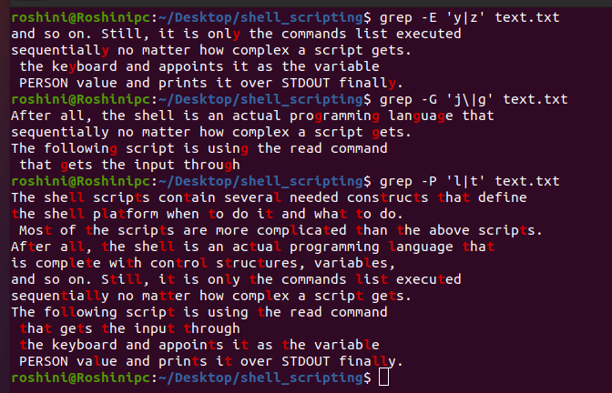
One Or More / Zero Or More
The * signifies zero or more times occurence of a pattern and + signifies one or more times occurence.
Syntax:
grep <option> <'pattern*'> <fileName>

Slide 73
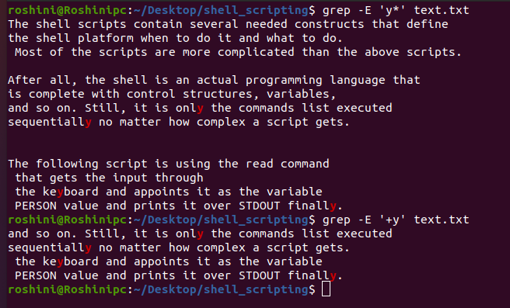

Slide 74
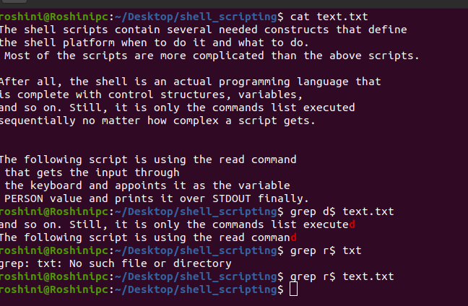
Match The End Of A String
To match the end of a string we use $ sign.
Syntax:
grep <pattern>$ <fileName>

Slide 75
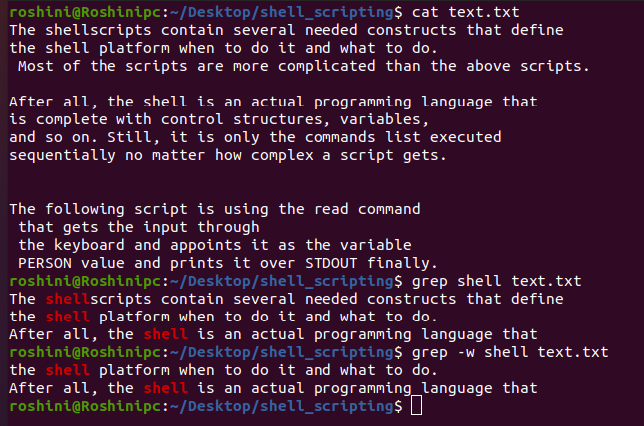
Separating Words
Syntax:
grep '\b<pattern>\b' <fileName>
After giving above command it will give lines with that pattern
This can also be done with -w

Slide 76
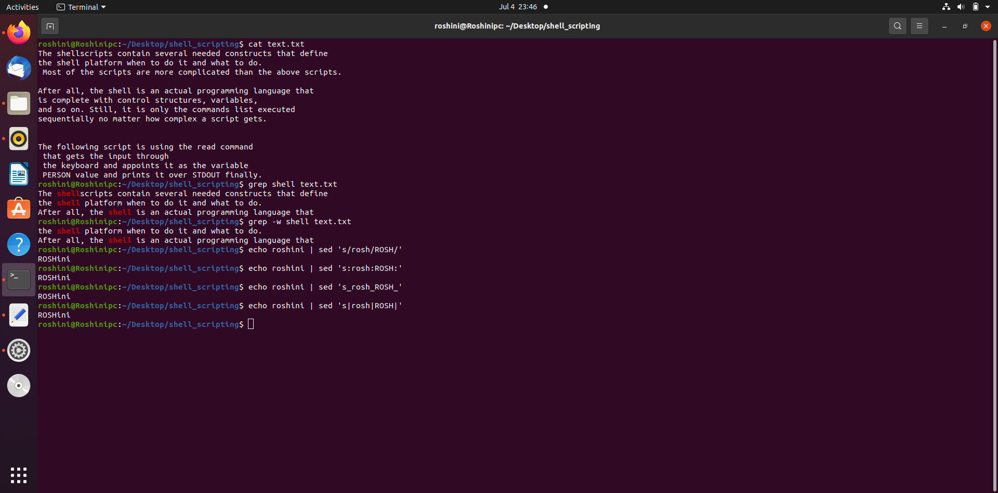
Linux Sed Regular Expressions :
Stream Editor
The sed command is used for stream editing.
string ‘roshini' is changed to ‘ROSHini' with sed command. Inspite of forward slash (/), colon (:), underscore (_) and pipe (|) will also work.

Slide 77
The sed General Syntax
/pattern/action
Here, pattern is a regular expression, and action is one of the commands given in the following table.
If pattern is omitted, action is performed for every line as we have seen above.
The slash character (/) that surrounds the pattern are required because they are used as delimiters.
Sr.No. | Range & Description
1 | p Prints the line
2 | d Deletes the line
3 | s/pattern1/pattern2/ Substitutes the first occurrence of pattern1 with pattern2

Slide 78
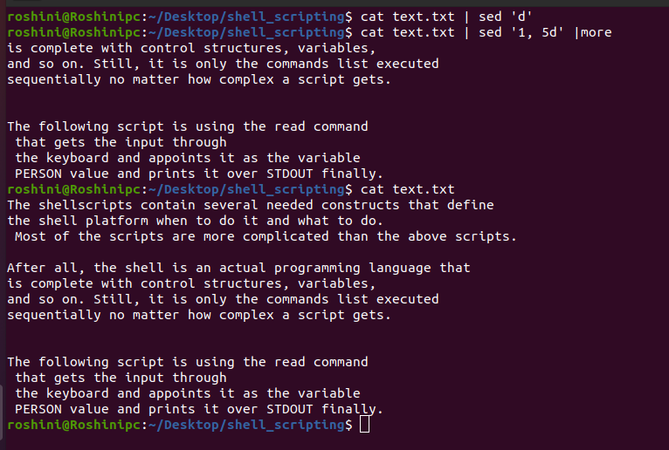
Deleting All Lines with sed
To delete cat file | sed 'd'
The sed Address
cat text.txt | sed '1, 5d' |more
The above command will be applied on all the lines starting from 1 through 5.
This deletes the first five lines.

Slide 79
Sr.No. | Range & Description
1 | '4,10d' Lines starting from the 4th till the 10th are deleted
2 | '10,4d' Only 10th line is deleted, because the sed does not work in reverse direction
3 | '4,+5d' This matches line 4 in the file, deletes that line, continues to delete the next five lines, and then ceases its deletion and prints the rest
4 | '2,5!d' This deletes everything except starting from 2nd till 5th line
5 | '1~3d' This deletes the first line, steps over the next three lines, and then deletes the fourth line. Sed continues to apply this pattern until the end of the file.
6 | '2~2d' This tells sed to delete the second line, step over the next line, delete the next line, and repeat until the end of the file is reached
7 | '4,10p' Lines starting from 4th till 10th are printed
8 | '4,d' This generates the syntax error
9 | ',10d' This would also generate syntax error

Slide 80
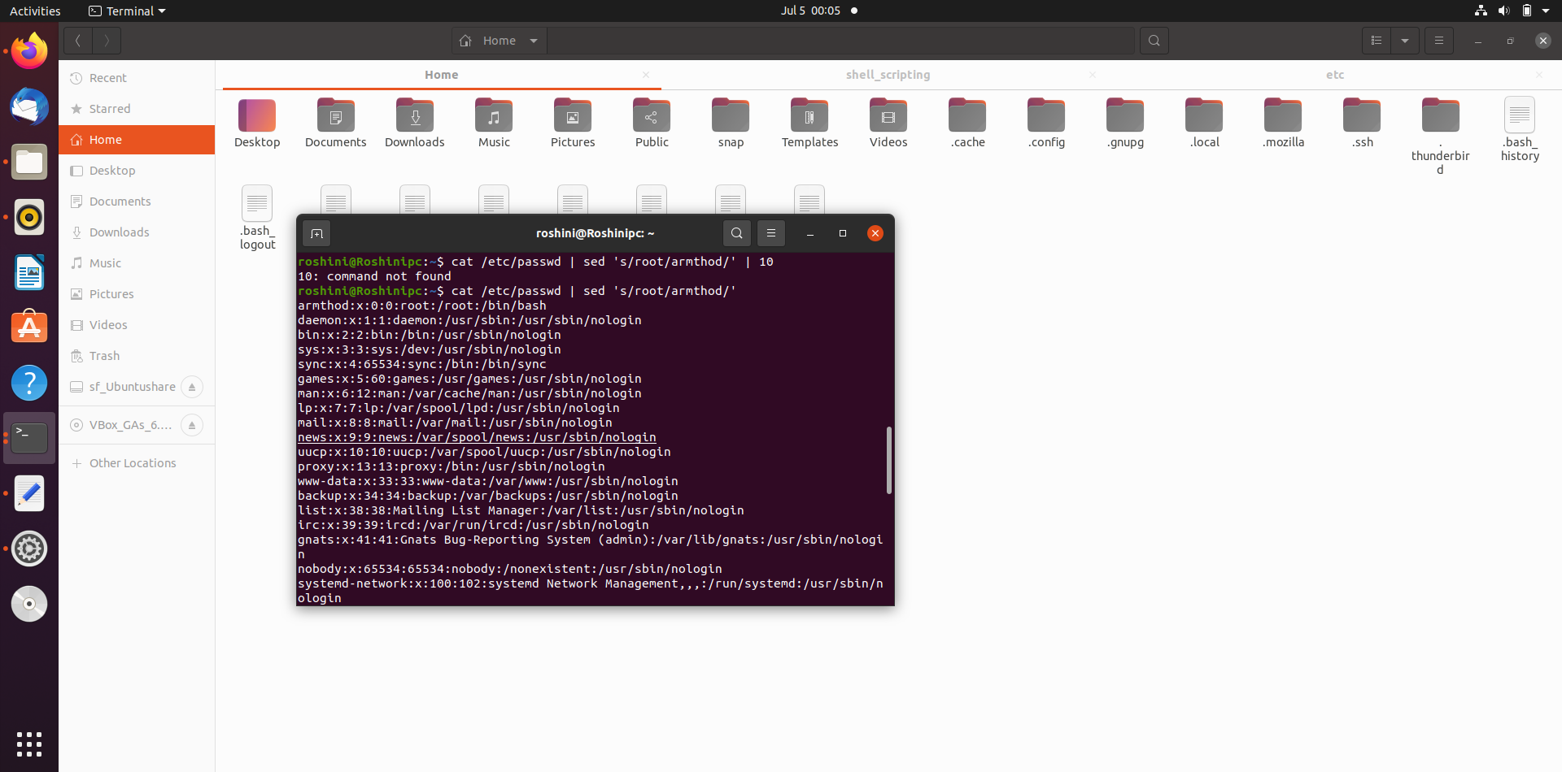

The Substitution Command
The substitution command, denoted by s, will substitute any string that you specify with any other string that you specify.
cat file | sed ‘s/string/pattern/’
The following command substitutes the first occurrence on a line of the string root with the string armthod.
To perform a global substitution, add the letter g to the end of the command
Cat file | sed ‘s/string/pattern/g’

Slide 81
cut command :
The cut command is used to display only specific columns or characters from a text file or from other command outputs.
-f (--fields=LIST) - Select by specifying a field, a set of fields, or a range of fields. This is the most commonly used option.
-b (--bytes=LIST) - Select by specifying a byte, a set of bytes, or a range of bytes.
-c (--characters=LIST) - Select by specifying a character, a set of characters, or a range of characters.
-d (--delimiter) - Specify a delimiter that will be used instead of the default “TAB” delimiter.
--complement - Complement the selection. When using this option cut displays all bytes, characters, or fields except the selected.
-s (--only-delimited) - By default cut prints the lines that contain no delimiter character. When this option is used, cut doesn’t print lines not containing delimiters.
--output-delimiter - The default behavior of cut is to use the input delimiter as the output delimiter. This option allows you to specify a different output delimiter string.

Slide 82
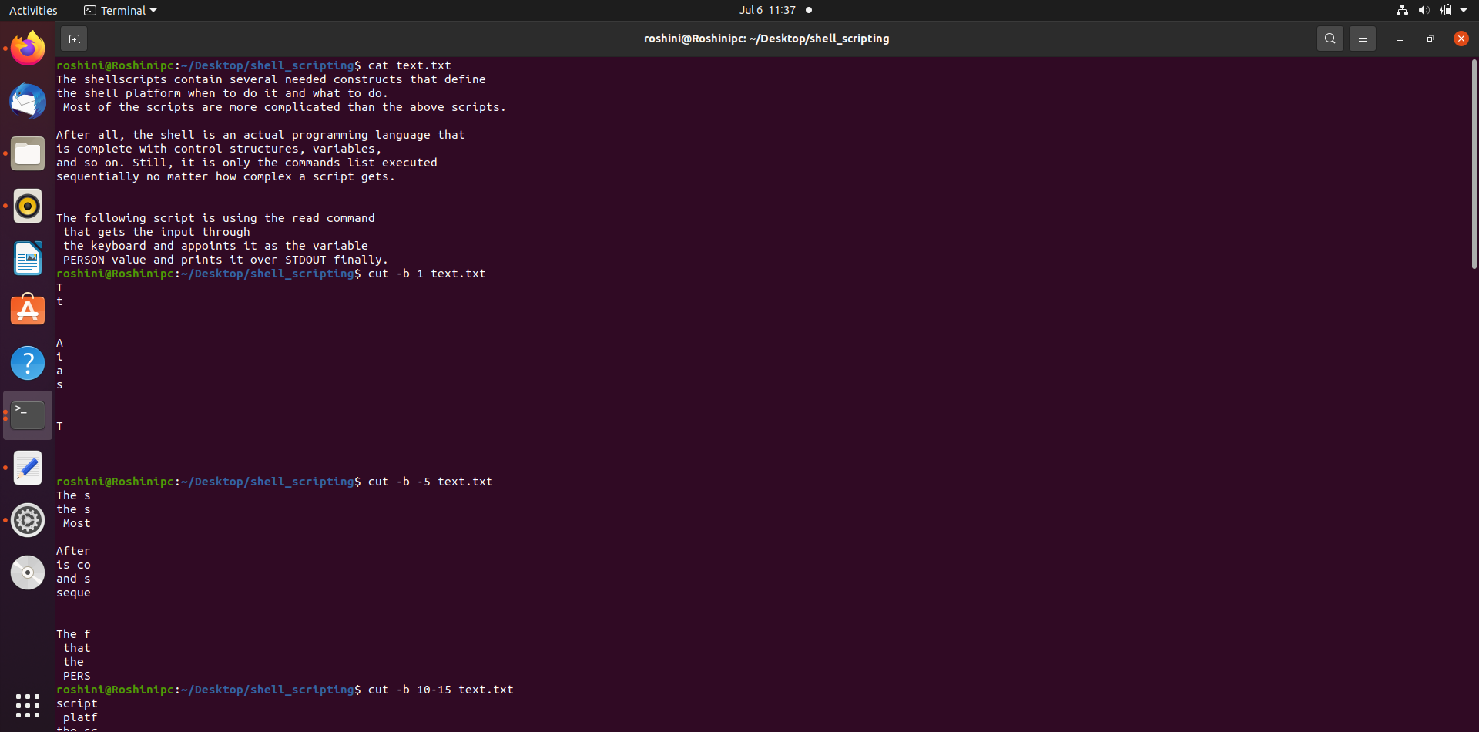
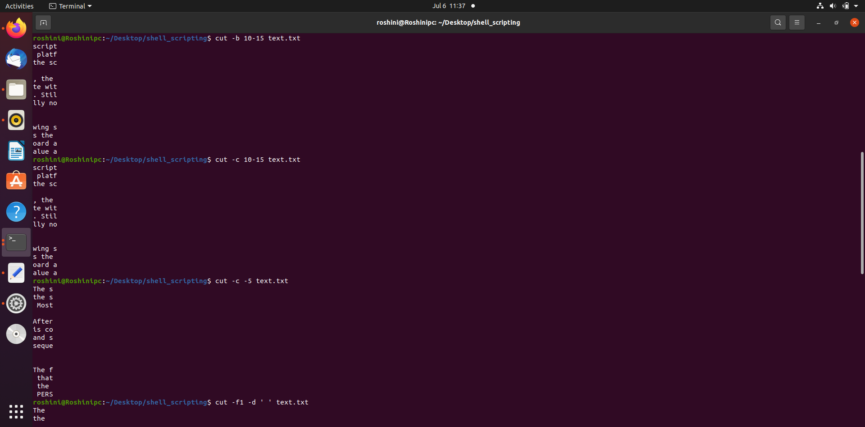
Cut by bytes -b :
The -b option allows you to extract data using bytes.
cut -b [list] [file]

Slide 83
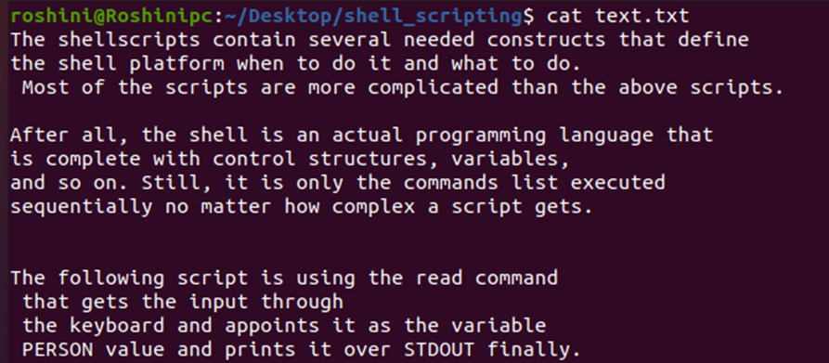
Cut by Characters -c :
To cut by characters, specify the -c option.
Cutting by characters is similar to cutting by bytes, except you need to specify the character position rather than the byte position.
cut -c [LIST] [file]

Slide 84
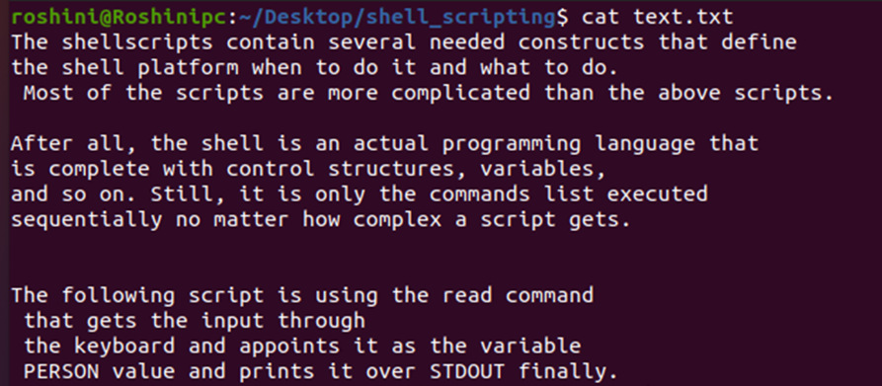
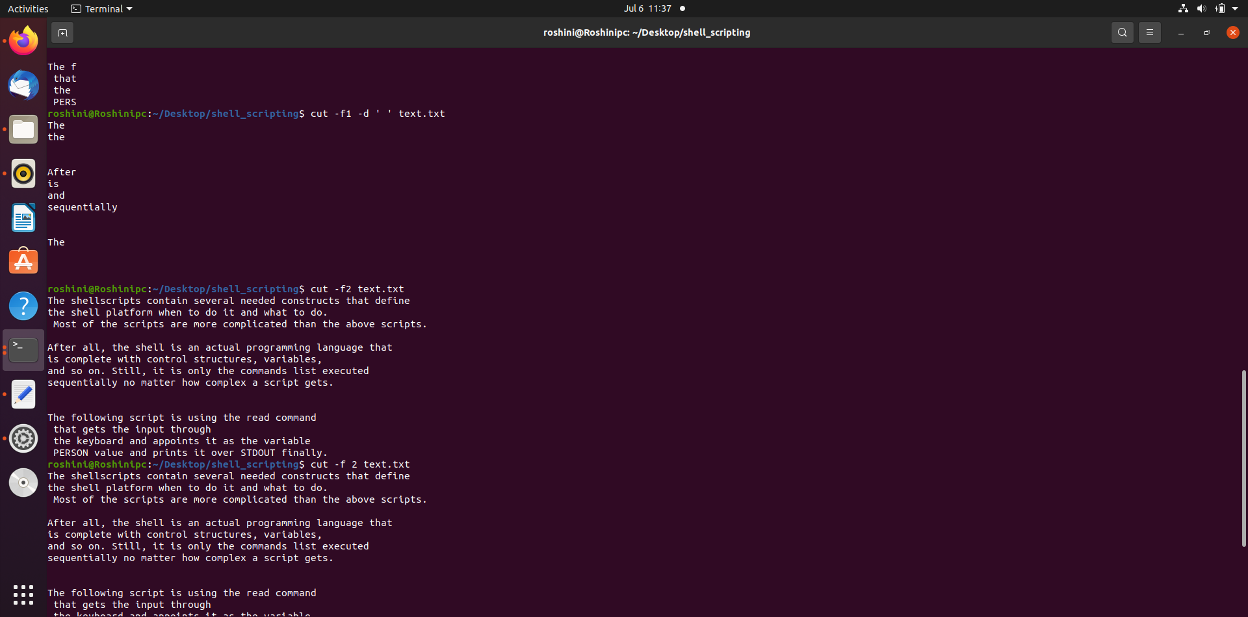
Cut Based on a Delimiter -d :
If the fields aren't separated by the default tab character, use the -d option to specify a different delimiter.
That means that the character specified after the -d option is considered the separator in the lines.
cut -d[delimiter] [file]

Slide 85

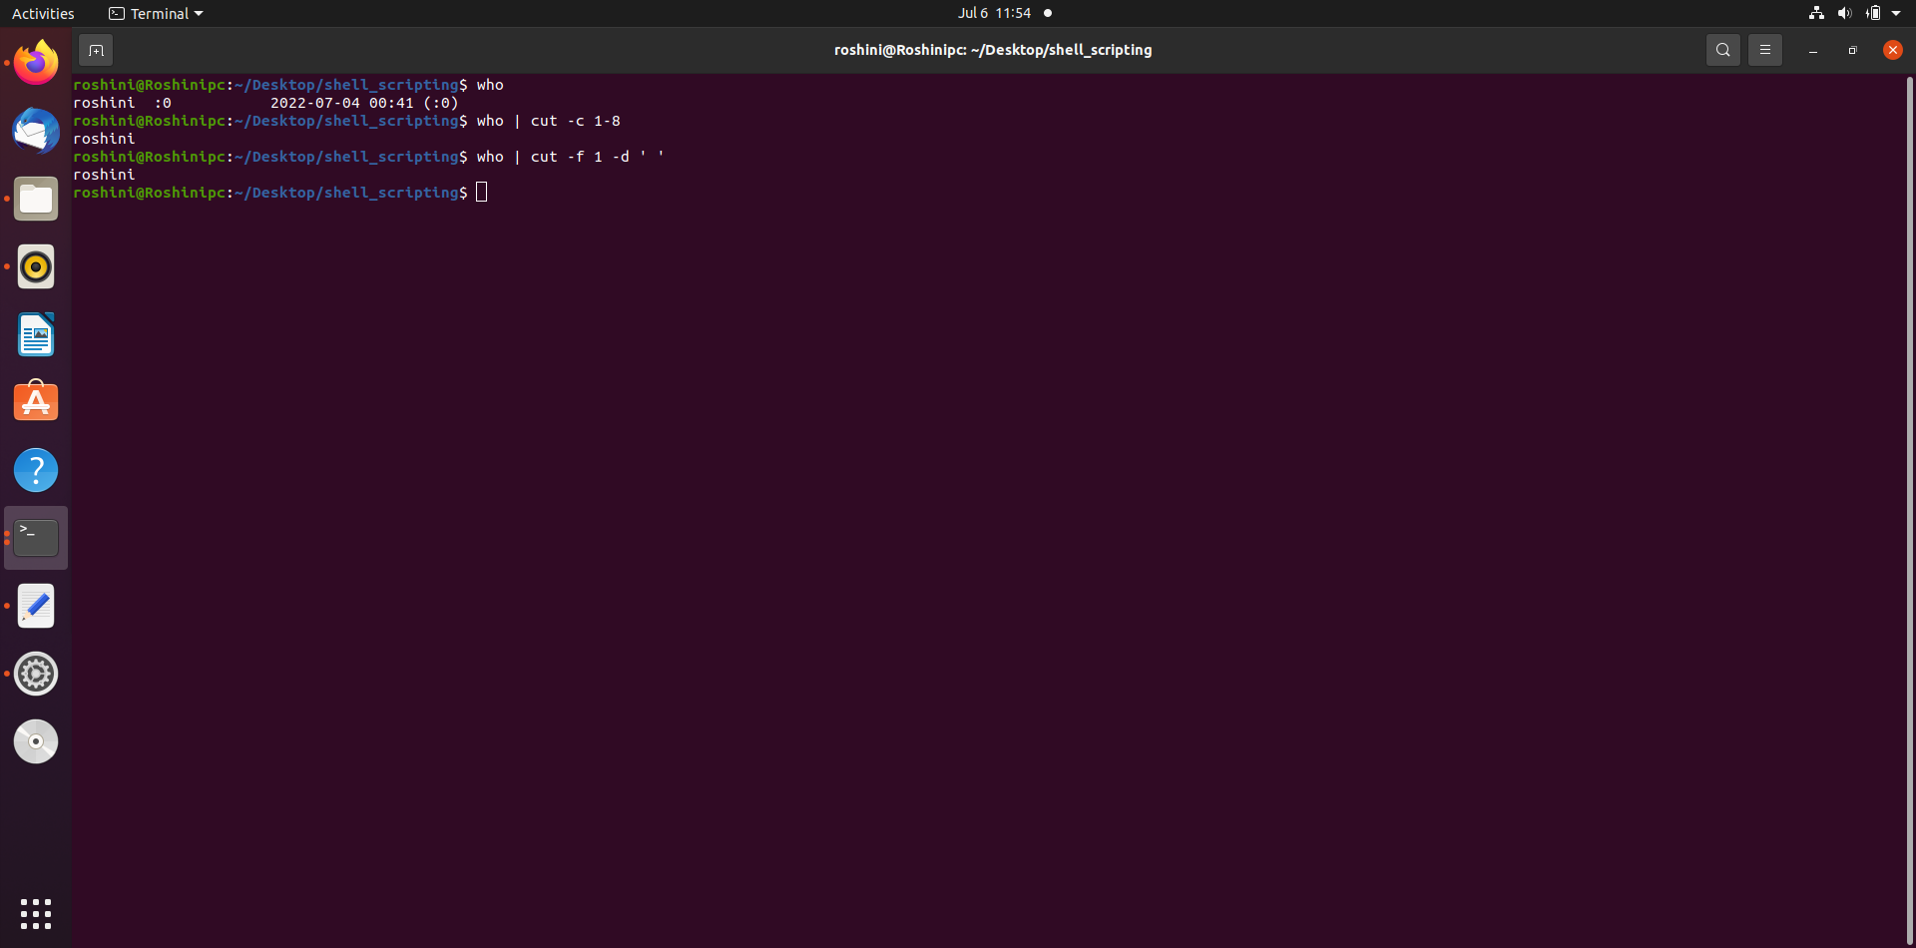
Cut by Fields -f :
When piping into commands whose output doesn't have a fixed format the -c option isn't helpful. Using the -f option to separate by fields is a better choice in that case.
cut -f [field] [file]

Slide 86
AWK Command:
The awk command is used for text processing in Linux.
Although, the sed command is also used for text processing, but it has some limitations,
so the awk command becomes a handy option for text processing.
It provides powerful control to the data.
The Awk is a powerful scripting language used for text scripting.
It searches and replaces the texts and sorts, validates, and indexes the database.

Slide 87
Features of AWK command:
Various features of the Awk command are as follows:
It scans a file line by line.
It splits a file into multiple fields.
It compares the input text or a segment of a text file.
It performs various actions on a file like searching a specified text and more.
It formats the output lines.
It performs arithmetic and string operations.
It applies the conditions and loops on output.
It transforms the files and data on a specified structure.
It produces the format reports.

Slide 88

Syntax:
awk '/regex pattern/{action}' your_file_name.txt
The data which is present in the text.txt file, with the help of this file we will see awk operations.
To print all the contents of the file using

Slide 89

If you would like each line to have a
line-number count,
you would use the NR built-in variable
To print specific columns using awk
The $1 stands for the first field, in this case the first column.

Slide 90
To print the second column,
you would use $2
To print more than one column, for example
the first and forth columns, you would do:
awk '{print $1, $4}’ text.txt

Slide 91

To print the last field (the last column),
you can also use $NF which represents
the last field
To print specific lines of a column use head
To print out lines with a specific pattern
in awk ‘/^pattern/’

Slide 92
To print a line that ends in a specific pattern
$ symbol is used after a character to siginify how a line will end.
The ! is used as a NOT, so in this case it selects the lines that DON'T end in with particular pattern.

Slide 93

To output words that contain certain letters and print out words that match a pattern you specify, you again use the slashes, //.
you wanted to see only the first and second column of the data when particular pattern present in that line.
awk ‘/pattern/{print $1 $2}’ filename
To use comparison operator
awk ‘$2 == pattern {print $0}’ text.txt

Slide 94
User administration :
User administration is the process of managing different user accounts and their respective permissions in an operating system
There are three types of accounts in a unix
Root account – Can run any command without any restrictions.
System account - For some specific functions like Gmail
User account – have only limited access
Here we can create different user accounts, sort them into groups, change their set of permissions or delete them
Unix supports a concept of Group Account which logically groups a number of accounts.
Every account would be a part of another group account.
A Unix group plays important role in handling file permissions and process management.

Slide 95
Managing Users and Groups :
Sr.No. | Command & Description
1 | useradd Adds accounts to the system
2 | usermod Modifies account attributes
3 | userdel Deletes accounts from the system
4 | groupadd Adds groups to the system
5 | groupmod Modifies group attributes
6 | groupdel Removes groups from the system
There are four main user administration files
/etc/passwd - Keeps the user account and password information. This file holds the majority of information about accounts on the Unix system.
/etc/shadow - Holds the encrypted password of the corresponding account. Not all the systems support this file.
/etc/group - This file contains the group information for each account.
/etc/gshadow - This file contains secure group account information.

Slide 96
Creating a user account :
To create a normal user account, we use the useradd command
sudo useradd [options] [username]
the username is the name by which we will create the new account.
Note that the name can not be the same for two users.
In the place of options, we can pass different flags to enable or disable different settings.
Modifying a user account :
To modify a user account we use the usermod command
usermod [options] [username]
In the above snippet, the username is the name of the account that is to be modified.
In the place of options, different flags are passed for different settings.

Slide 97
Option | Description
-b, --base-dir BASE_DIR | This option is used to specify the default base directory for the new user being created. BASE_DIR is concatenated with the account name to specify the base directory if the -d flag is not used to define the home directory.
-c, --comment COMMENT | This option is used to write a short description of the new account. It is also used as the user's full name for the time being.
-d, --home HOME_DIR | This option is used to specify the home directory for the newly created user.
-D, --defaults | This option is used to display the current default values for the `useradd` command
-e, --expiredate EXPIRE_DATE | This option is used to specify the date in the YYYY-MM-DD format on which the newly created user account will be disabled.
-f, --inactive | This option is used to specify the number of days that the account will stay active after its password has expired.
-g, --gid GROUP | This option is to specify the name or number of the group of newly created user.
-G, --groups Group1[,Group2,...[GroupN]]] | This option is used to specify a list of groups which will be joined by the newly created user.

Slide 98
-h, --help | This option is to display the help message
-k, --skel SKEL_DIR | This option is used to specify files and folders which will be copied into the home directory of the newly created user.
-K, --key KEY=VALUE | This option overrides the default values present in /etc/login.defs. These inclue UID_MIN, UID_MAX, UMASK etc.
-I, -no-log-init | This option prevents the user to be added from the lastlog and faillog databases.
-m, --create-home | This option is used to create the user's home directory if it does not exist.
-M | This option is used to prevent the creation of the home directory.
-N, --no-user-group | This option is used to prevent the creation of a group with the user's name.
-o, --non-unique | This options allows the creation of a user account with a duplicate ID.
-p, --password PASSWORD | The encrypted password, as returned by the `crypt`.

Slide 99
-r, --system | This option is used to create a system account.
-s, --shell SHELL | This option is used to specify the name of the user's login shell.
-u, --uid UID | This option is used to set the numerical value of the user' ID. This value must be unique.
-U, --user-group | This option enables the creation of a group with the same name as the user's name.
-Z, --selinux-user SEUSER | This option is used to determine the SELinux user for the user's login.
Deleting a user account :
To delete a user account we use the userdel command
userdel [options] [username]
In the above snippet, the username is the name of the account that is to be modified.
In the place of options, different flags are passed for different settings.

Slide 100
Groups :
In Linux or Unix-based operating systems, we can form groups of users accounts.
Groups are used to manage the user accounts collectively.
We can manage the access permissions for the entire group.
A single user can be a part of multiple groups, and a group can have multiple users.
Creating a new group :
We use the groupadd command to create a new group.
groupdadd [options] [groupname]
groupname is the name assigned to the newly created group.
In place of options, we can pass different flags for different settings.

Slide 101
Modifying a group :
We use the groupmod command to modify an existing group
groupmod [options] [groupname]
groupname is the group’s name that is to be modified.
In place of options, we can pass different flags for different settings.
Deleting a group :
To delete a group, we use the groupdel command
groupdel [groupname]
groupname is the group’s name that is to be deleted.

Slide 102
System Performance :
It is very important to check the state of the operating system
Linux has following major resource types that need to be monitered and tuned
CPU
Memory
Disc space
Communication lines
I/O time
Network time
Application programs

Slide 103
Sr.No. | Component & Description
1 | User State CPU The actual amount of time the CPU spends running the users’ program in the user state. It includes the time spent executing library calls, but does not include the time spent in the kernel on its behalf
2 | System State CPU This is the amount of time the CPU spends in the system state on behalf of this program. All I/O routines require kernel services. The programmer can affect this value by blocking I/O transfers
3 | I/O Time and Network Time This is the amount of time spent moving data and servicing I/O requests
4 | Virtual Memory Performance This includes context switching and swapping
5 | Application Program Time spent running other programs - when the system is not servicing this application because another application currently has the CPU

Slide 104
Performance Tools :
Sr.No. | Command & Description
1 | nice/renice Runs a program with modified scheduling priority
2 | netstat Prints network connections, routing tables, interface statistics, masquerade connections, and multicast memberships
3 | time Helps time a simple command or give resource usage
4 | uptime This is System Load Average
5 | ps Reports a snapshot of the current processes
6 | vmstat Reports virtual memory statistics
7 | gprof Displays call graph profile data
8 | prof Facilitates Process Profiling
9 | top Displays system tasks

Slide 105



Slide 106
System Loggings :
Unix systems have a very flexible and powerful logging system.
Many versions of linux provide a general-purpose logging facility called syslog
Centralized system logging process that runs the program /etc/syslogd or /etc/syslog
Logging actions :
Log message to a file or a device
For example, /var/log/lpr.log
Send a message to a user
Pipe the message to a program
Send the message to a syslog on another host

Slide 107


Slide 108


Slide 109

Traps and signals :
Signals are software interrupts sent to a program to indicate that an important event has occurred
The events can vary from user requests to illegal memory access errors
Some signals, such as the interrupt signal, indicate that a user has asked the program to do something that is not in the usual flow of control
Check man page for signals – man 7 signal

Slide 110


Trapping Signals :
Trap enables you to capture signals and run code when they occur.
$ trap commands signals
Ignoring Signals :
If the command listed for trap is null, the specified signal will be ignored when received. For example, the command
$ trap ' ' 2

Slide 111



Slide 112
Thank you

